Slide 1
Resource recommendation based on user extracted profile and social context from social networks

Slide 2
Administrative news
PhD last year funded by Open Insights (U.S.) company.
Dr. Usama Fayyad is the co-director of the PhD
PhD director: US: (Caltech, at Stanford, USC…) India and Australia. [First PhD in Europe is with our team]
One of the founders of the fields of data mining and
corporate data strategy.
Five years at Microsoft directing the data mining and exploration efforts
Formerly Yahoo!'s Chief Data Officer and Executive VP
Founder of Yahoo!'s research organization
CEO of Open Insights.
…

Slide 3
Plan
Context.
Proposition and model.

Slide 4
Context
Resource recommendation for users
Users are surrounded by millions of resources.

Slide 5
Context
Resource recommendation for users
Users are surrounded by millions of resources.
User has different contexts, different roles individually.

Slide 6
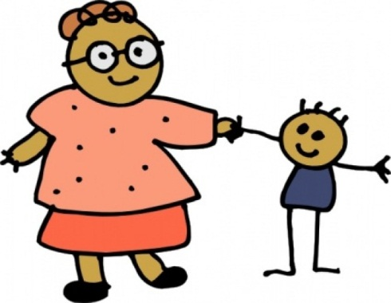
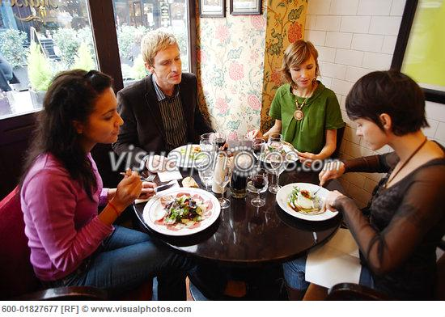
Context
Resource recommendation for users
Users are surrounded by millions of resources.
User has different contexts, different roles individually.
User has different contexts, different roles socially

Slide 7
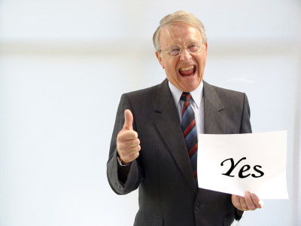
Context
Resource recommendation for users
Users are surrounded by millions of resources.
User has different contexts, different roles individually.
User has different contexts, different roles socially
Recommendation is all about how to offer to users the best resources matching their interest, preferences, profiles, and context.

Slide 8
Recommendation?
Recommendation (Su 2009)
Collaborative filtering (user-user, item-item…)
Content based matching
Hybrid solutions

Slide 9
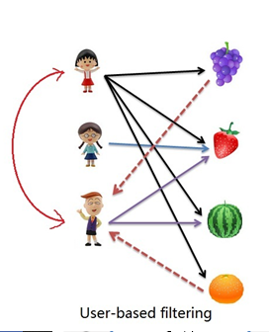
User_user CF (Xu 2012)
U_U: Relies on existence of other similar users to recommend the user the resources that might interest him (predicting rating)
Matrix + predication of rating.

Slide 10
User-User Collaborative filtering (-)
Sparse data ➔ no real time update.
Poorly suited for providing recommendation for users that have unusual tastes.
No mechanism for favoring items that are currently « hot seller »
No mechanism for recognizing that user is searching for a particular item type or category of items.
Amazon patent 2006
Cold start problem.
The user is recommended like totally similar users.
No context recommendation at all.

Slide 11
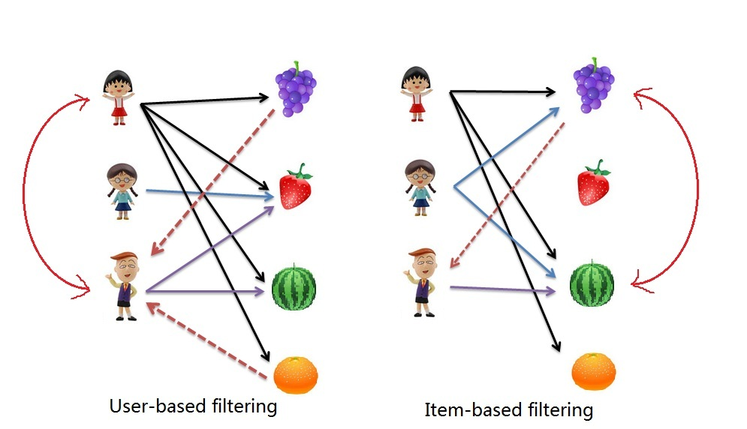
Item_Item CF (amazon 2006)
I-I: Relies on the collected information about the items, based on users actions, so the items tend to be similar, viewed togather, bought together…

Slide 12
Item-Item Collaborative filtering (-)
Sparse data (less than User-user): no real time update.
You don’t get very much diversity or surprise in item-to-item recommendations, so recommendations tend to be kind of “obvious” and boring.
Edwin Chen Data scientist at Twitter. Previously math and linguistics at MIT, quantitative trading at Clarium Capital. Feb 15th, 2011
Cold start problem
As user is not there ➔ no context or role.

Slide 13
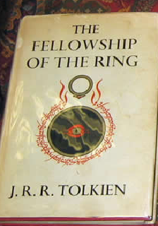
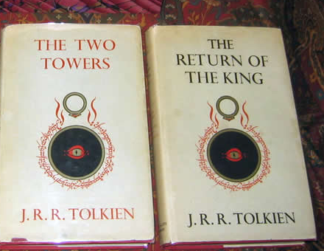
Content based solutions (ref)
Based on the content of a resource to find its similar items (CSP).
Work in combination with CF to offer recommendation.
Similar items➔ Similar ratings

Slide 14
We aim to overcome the cold start of the user
And to include his roles, interest, profiles, shopping preferences, context, social context in the recommendation process

Slide 15
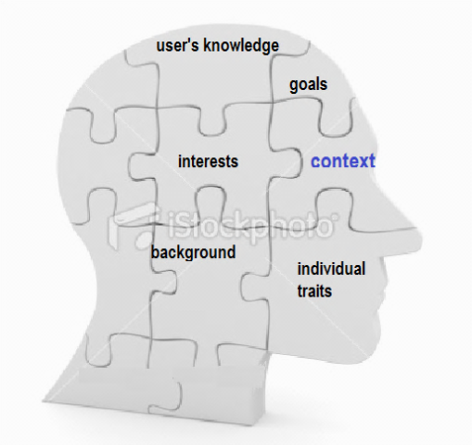
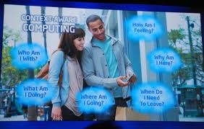
User profile and context
User profile (Brusilovsky 07):
Knowledge, Background, Goals,
Individual traits, Interest.
Context (Dey 2000):
Context is any information that can be used to characterize the situation of an entity. An entity is a person, place, or including the user and applications themselves.
Context elements: ???

Slide 16
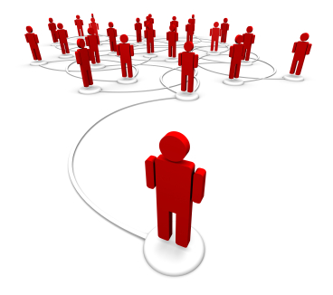
Context awareness and social context
Context awareness (Dey 2000):
is the application that takes into consideration the context like location, time, weather…
Social context (Sur 2009):
the part of context related to the relation with others.
The most difficult to deal with.
Most context aware application are locational ones

Slide 17
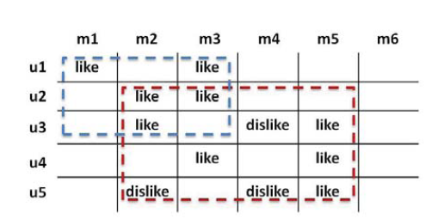
Related work to (Role)
[Xu 11, www] Give recommendation that respect the different roles of users based on clustering their activities (CF).
facet based collaborative filtering: find sub clusters of users.
But ➔ still cold start !

Slide 18
Related to (context)
[Mizzaro, 11, www] A social approach to context-aware retrieval
[T. Kramár, 11] Towards contextual search: social networks, short contexts and multiple personas
[Olaru 11] Use context graph & SMA for the AmI Environments:
A good model
But ➔ the context patterns are provided to the system.

Slide 19
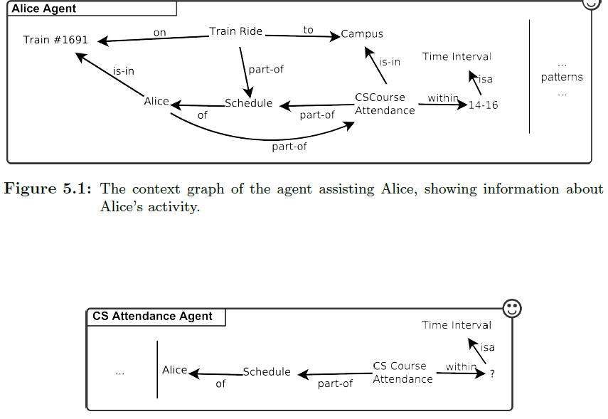
Ex: Olaru

Slide 20
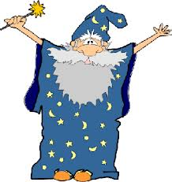
!
Our targeted system should have information about the user without he communicating this information directly
But from where?
SN: face book
Twitter

Slide 21
Social networks (Facebook, twitter)
On Social networks [Grimmelmann, 09] users do actions to:
Identity: define a self image.
Relation: offer relations with others.
new relations
keeping old ones.
Community: broaden user’s community by showing others similar to him.

Slide 22
Social networks (Facebook, twitter)
The good news: Users actions on Social networks give real information about them [10, Back]

Slide 23
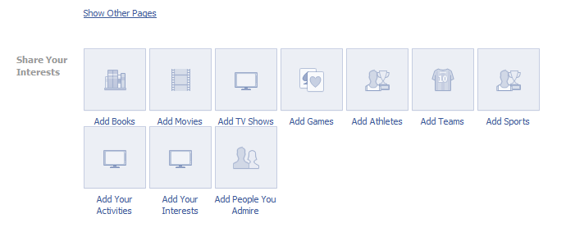
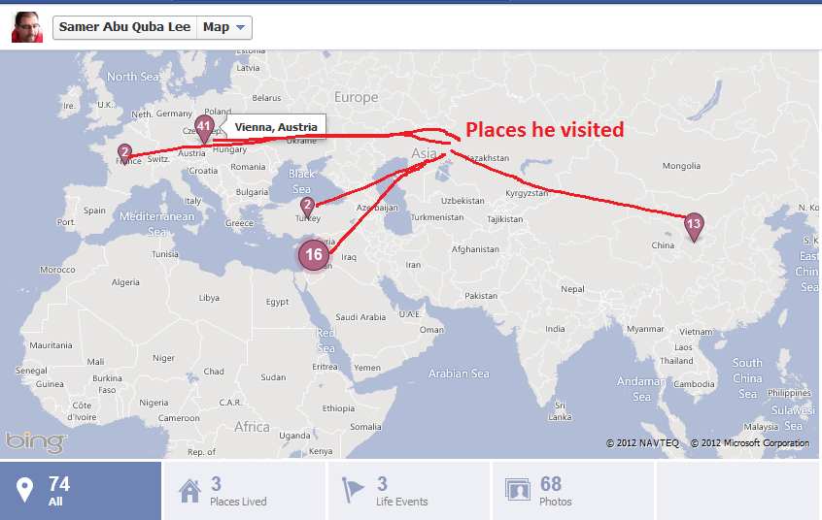
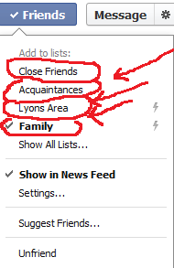
Users actions’ on facebook

Slide 24
Users actions’ on facebook
Build a profile
Update a status
Invite friends
Add interest (book, movie, activities…)
Comment, share, like, add place, classify friends

Slide 25
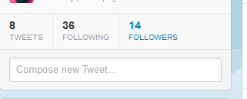
Users actions on twitter
Tweet
Re-tweet
Follow
Build a profile

Slide 26
SN are our window to the real world
White box
Black box
Social networks: Facebook, twitter…
Real world actions
User profile
User social context
User context

Slide 27
Some Related work: Social network as source of information
[Abel, 10] Interweaving Public User Profiles on the Web.
[Golbeck, 11] Predicting personality with social media,
[Denti 12] Sweden’s largest Facebook study
[Fabian 11] Works in building user profiles from social neworks –twitter- to provide tag_based profile + topic based profile.

Slide 28
Most of the work related to the social context and social network is very new (2010 +)

Slide 29
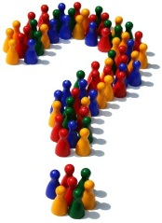
Problems and goals
Questions: based on the social networks:
Can we solve the cold start problem
build a user profile:
Interests
Extract shopping preference profiles and commercial trends
User roles
Can we find the user context, social context?
And then, how to recommend.

Slide 30
Plan
Context.
Proposition and model.

Slide 31
The system = (S1, S2, S3, S4)
System of recommendation S3
Auto-organized system
System of adaptation S4
System of knowledge extraction S2
system acquisition of user information S1

Slide 32
S1: System of acquisition of user information
Taking all users actions from Facebook and twitter:
Facebook: taking a permission of the user (1100 user in the Database:
http://fb.choozon.net/facebookData/consent
http://fb2.choozon.net/facebookData/oneUse
Twitter: no permission (most of the cases)
Resulting data Like the sensors in a context system, very low level ones! (big data)
➔ System S2

Slide 33
S2: System of knowledge extraction
The input of the system is the out put of S1:
The entity items.
System S2 will work like the following

Slide 34
S2: System of knowledge extraction: (TD with UML)
5 Extract user profile info
S1
4 Find the concepts of the keywords
3 Weight the keywords
8 building the user shopping profile
1 Clustering users’ information (roles)
2 Build a tag cloud for every role
6 extracting context
7 Extracting Social context
S2

Slide 35
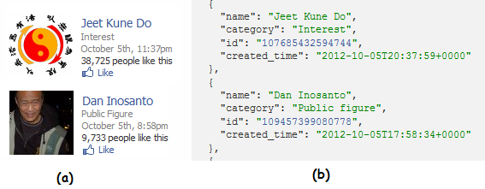
4 Find the concepts of the keywords
Why?
Without the concept:
Who is Ghandi, Bruce lee?
No relation between Dan Inosanto and Jeet Kune Do

Slide 36
4 Find the concepts of the keywords
Word net ?
Wikipédia Data base?
Looking into google?
Easier way:
using the description in the pages of the two likes
the “martial arts” appears clearly to address a strong relation:

Slide 37
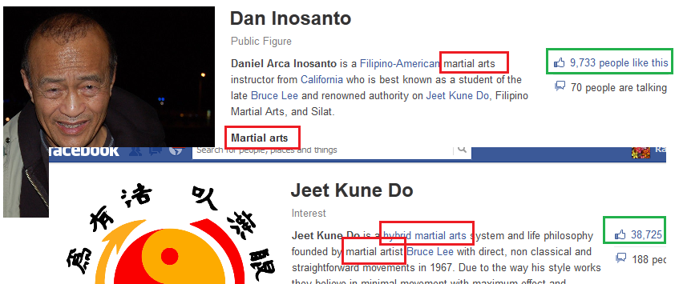
4 Find the concepts of the keywords

Slide 38
4 Find the concepts of the keywords Concept Profile
Concept based profile for a user u €U is a union of set of weighted concepts.
The concepts cp € CP and the weights w(cp,u) are calculated based on users actions in social networks using the ConceptPAlgo.
ConceptP(u)= {U (cp, w(cp,u)): cp € C, u €U}

Slide 39
S2: System of knowledge extraction: (TD with UML)
5 Extract user profile info
S1
4 Find the concepts of the keywords
3 Weight the keywords
8 building the user shopping profile
1 Clustering users’ information (roles)
2 Build a tag cloud for every role
6 extracting context
7 Extracting Social context
S2

Slide 40
3 Weight the keywords
For now it is the frequency !

Slide 41
S2: System of knowledge extraction: (TD with UML)
5 Extract user profile info
S1
4 Find the concepts of the keywords
3 Weight the keywords
8 building the user shopping profile
1 Clustering users’ information (roles)
2 Build a tag cloud for every role
6 extracting context
7 Extracting Social context
S2

Slide 42
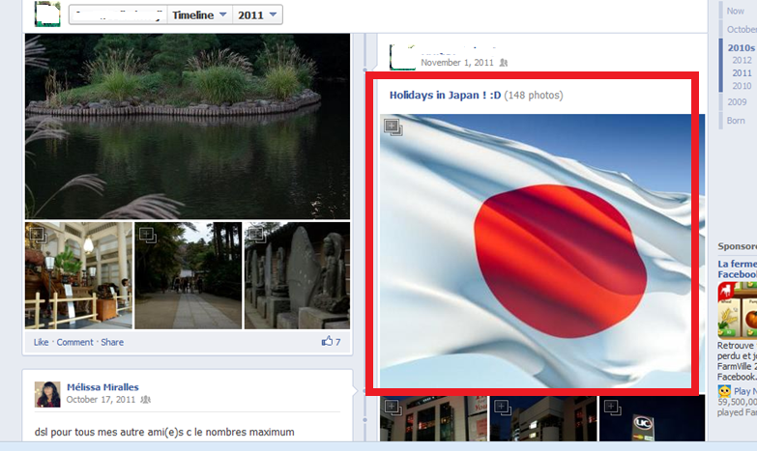
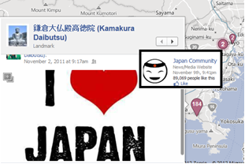
1 + 2 Roles tag clouds:
Based on the user actions all over Facebook:
Stemming
Clustering
Finding concepts (4)

Slide 43
1 + 2 Roles tag clouds: actions about sport ➔ sport role

Slide 44
S2: System of knowledge extraction: (TD with UML)
5 Extract user profile info
S1
4 Find the concepts of the keywords
3 Weight the keywords
8 building the user shopping profile
1 Clustering users’ information (roles)
2 Build a tag cloud for every role
6 extracting context
7 Extracting Social context
S2

Slide 45
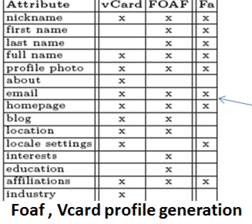
5 Extract user profile info (fabian 11)
Easy mission

Slide 46
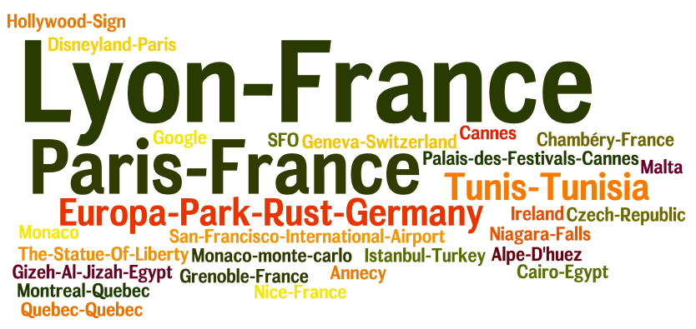
6 Extracting context
Location + time + actions in the that specific time + location are provided (if user has entered them)

Slide 47
7 Extracting Social context
Extracting with every tag cloud (Role) the users (friends, followers) who did actions related to that action.

Slide 48
8 building the user shopping profile
Building the algorithm

Slide 49
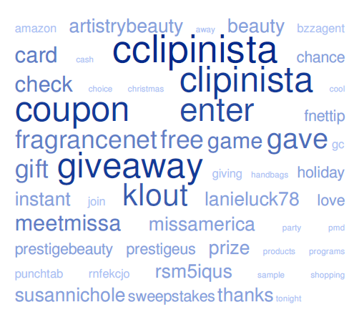
Twitter tag cloud: ex

Slide 50
S2 system on twitter
Tweet? Retweet? Followers
What to include or not in the role building algorithm?
How to weight the keywords?
How to do to concept matching?
How to do the preference analysis
Shall we use the followers’ bio?

Slide 51
S2: System of knowledge extraction: (TD with UML)
5 Extract user profile info
S1
4 Find the concepts of the keywords
3 Weight the keywords
8 building the user shopping profile
1 Clustering users’ information (roles)
2 Build a tag cloud for every role
6 extracting context
7 Extracting Social context
S2

Slide 52
The system = (S1, S2, S3, S4)
System of recommendation S3
Auto-organized system
System of adaptation S4
System of knowledge extraction S2
system acquisition of user information S1

Slide 53
S3 System of recommendation
First : a matching algorithm.
Second: use the definition of Ferber as a filtering tool:
The MASQ model of Ferber was basically proposed for designing OCMAS (Organization Centered Multi-Agent Systems).
The approach adopts a two axes division: the (individual, collective) aspect from one side, and the (interior like mental state and representation, exterior like behavior, objects and organizations)

Slide 54
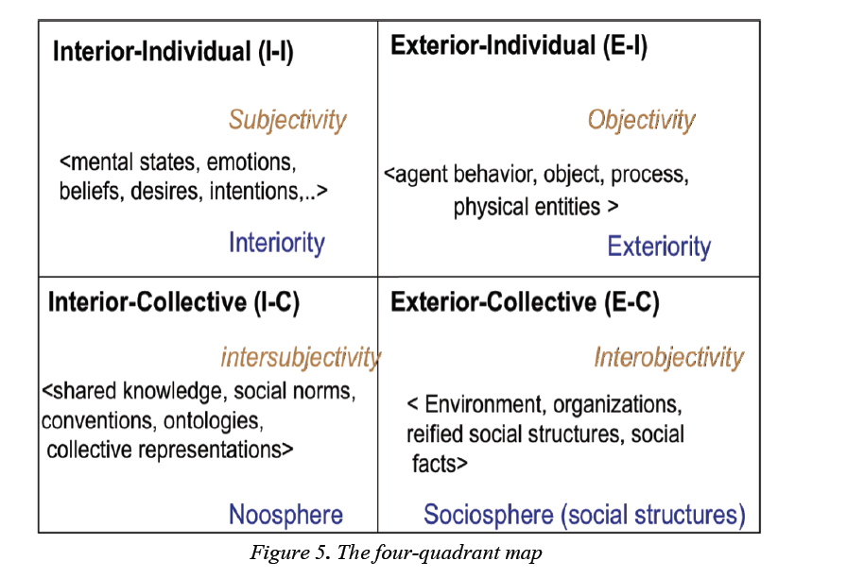
S3 System of recommendation Ferber 4 quadrants

Slide 55
S3 System of recommendation
SMA:
Infer about resource and the profile (ex: product and commercial trend)

Slide 56
S3 System of recommendation
The input for this system is the output of S2
The agents will order the information into the 4 quadrant
The agants will share the load by specializing in different quadrants.

Slide 57
S3 System of recommendation Ferber 4 quadrants
Background
Activity
Knowledge
Personal traits
interest
location
goals
Role
time
Role
interest
Relation
Activity
Shared interests

Slide 58
S3 System of recommendation
the agant will use the quadrant as a filtering tool to know
what quadrant is active
How to recommend based on it.
The agents have to predict the active quadrant to do the recommendation.

Slide 59
S3 System of recommendation
4 quadrants
Recommendation
S2

Slide 60
Recommandation
S3
Context
Interior-individual
Exterior-Individual
Interior- Collective
Exterior-Collective
Profile
Social networks

Slide 61
Recommandation
S3
Context
Interior-individual
Exterior-Individual
Interior- Collective
Exterior-Collective
Profile
Social networks

Slide 62
Recommandation
S3
Context
Interior-individual
Exterior-Individual
Interior- Collective
Exterior-Collective
Profile
Social networks

Slide 63
System of adaptation S4
The system will update the next recommendation based on the user reaction.
A system multi agant will use the MASQ framework to perform the adaptation.

Slide 64
Blue kangaroo (ChoozOn)
www.bluekangaroo.com
Blue kangaroo might be the space where we can test our methodology of user profiling and recommendation.
News recommendation can be used too to test our system

