Slide 1
BIM-GIS INTEGRATED GEOSPATIAL INFORMATION MODEL USING SEMANTIC
WEB AND RDF GRAPHS
Diego Vinasco 31/03/2021
Abdel-Hadi Hor, Gunho Sohn, Mojgan Jadidi
Notes:
Représentation, à l’aide de graphes de données urbaines

Slide 2
Definition : Sémantique
Données sémantiques → données thématique ou non-spatiales/non-géométriques

Slide 3
Contexte : intégration de données pour calculer des routes d'évacuation
CityGML (City Geography Markup Language):
BIM-IFC (Building Information Model-Industry Foundation Classes)
IGIM (Integrated Geospatial Information Model)

Slide 4
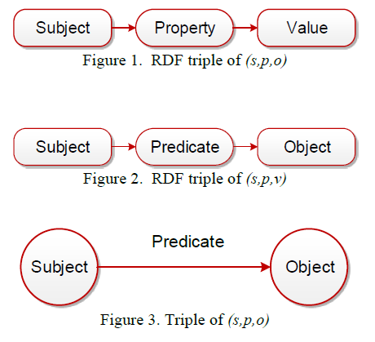
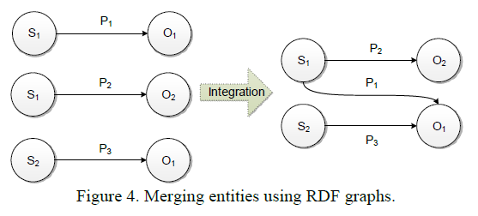
Intégration par les graphes sémantiques

Slide 5
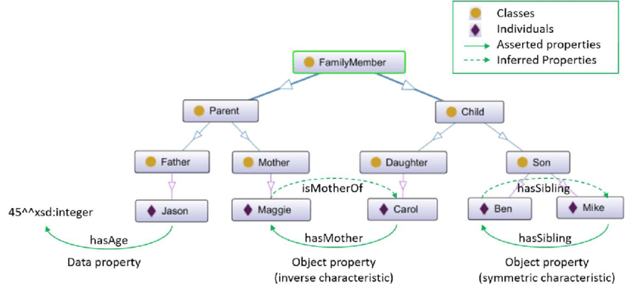
Exemple d’un ontologie

Slide 6
IGIM : Ontologie et definition du schema
 | IFC | CityGML | Web Sémantque
Schema | EXPRESS | UML | OWL
Data | STEP | GML3 | RDF
Identifier | GUID | ObjectID | RDF
Query |  | SQL | SPARQL

Slide 7
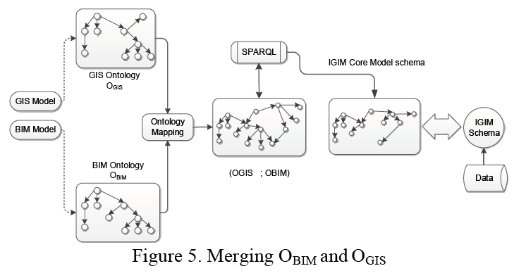
IGIM : Ontologie et definition du schema
Règles pour le mapping :
Equivalent: Object A (from GIS) is Equivalent to Object B (from BIM)
As-is: Object A is taken into the resulting ontology as-is to avoid redundancy or because of richness of semantics
Has an attribute: Object A has a attributes needed by object B

Slide 8
Mapping par Graph Matching for Ontologies (GMO)
Parse OBIM and OGIS and transform them to corresponding RDF bipartite graphs.
Classify entities in OBIM and OGIS as classes, properties and instances
Coordinate OBIM and OGIS using coordination rules
Discarding
Merging
Inference
List
Determine external entities for OBIM and OGIS and setup external similarity matrix.
Setup matrix representation for OBIM and OGIS.
Initialize the similarity matrices.
Run Iteration step with updating equation until some predefined convergence precision is reached.
Find 1:1 mapping by means of similarity matrix.

Slide 9
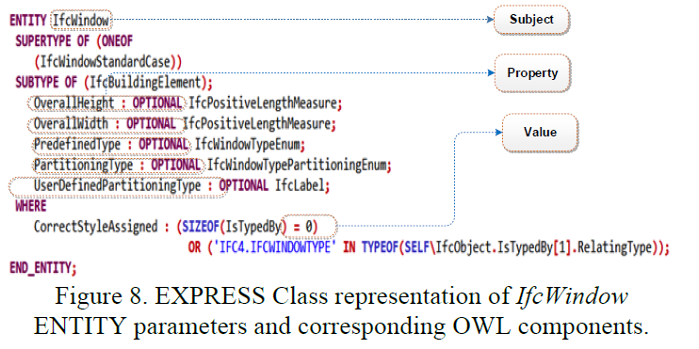
Formalisation de concepts et relations : IFC

Slide 10
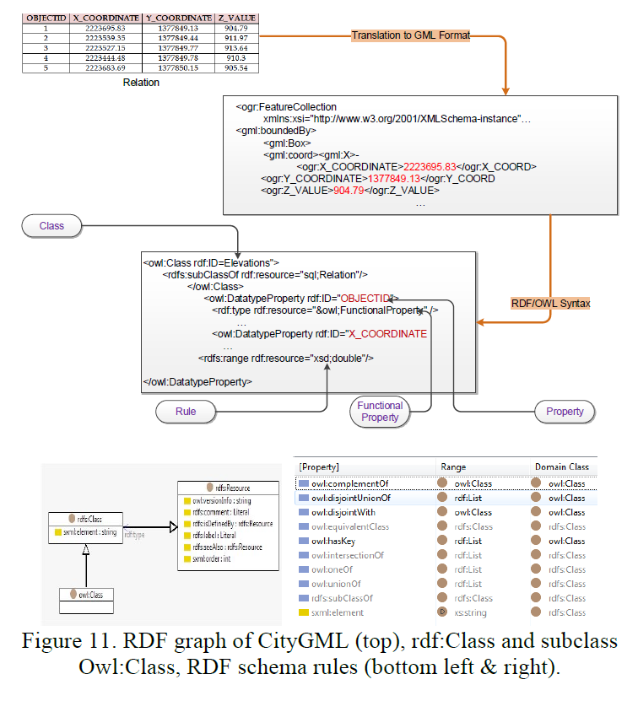
Formalisation de concepts et relations : CityGML

Slide 11
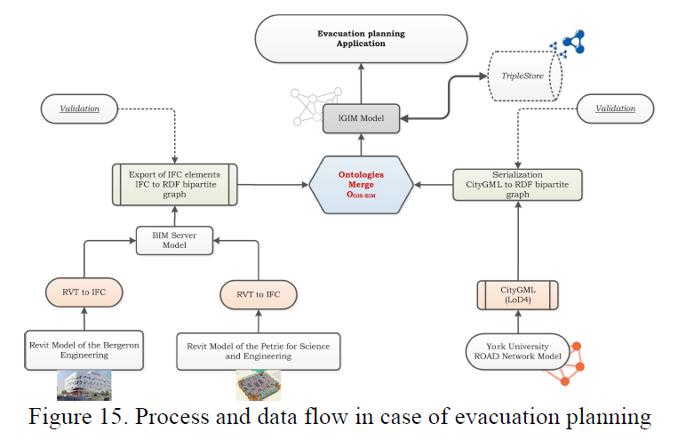
Implementation IGIM

Slide 12
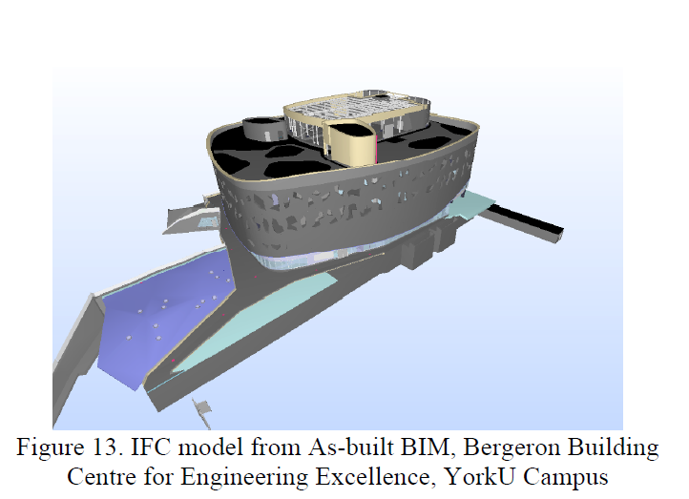
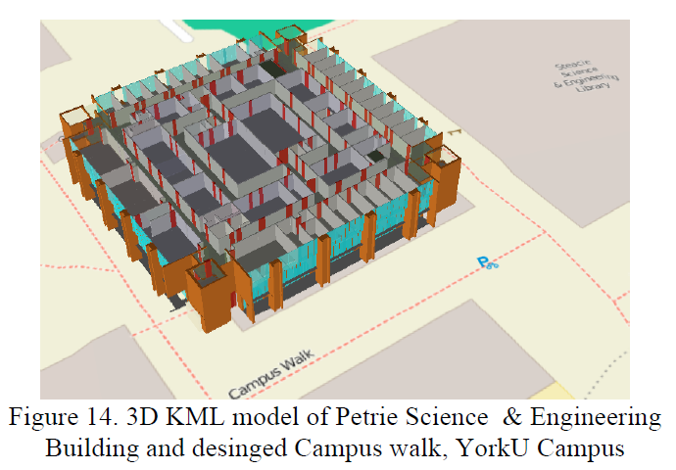
Modèles 3D intégre

Slide 13
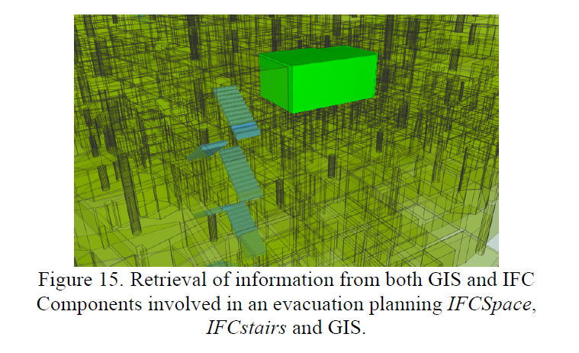
Resultat : Planification de routes d'évacuation
Pièce
Escaliers

