Slide 1
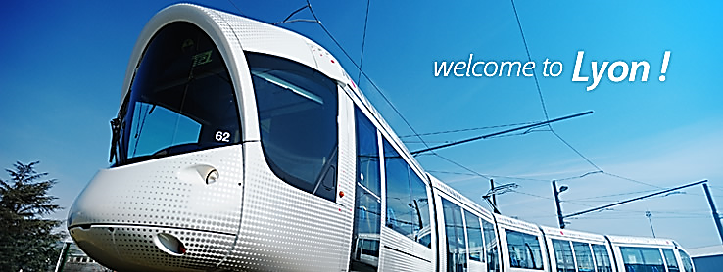
Transport mode detection in the city of Lyon using mobile phone sensors
Jorge Chong
Internship for MLDM M1
Jean Monnet University
2017-09-15

Slide 2
Agenda
Introduction
State of the art
Work done
Notes:
Explain the agenda of the presentation

Slide 3
Introduction

Slide 4
Notes:
Project Mobicampus:
This work is done in the context of Project Mobicampus
Goal of mobicampus is to combine and compare user survey and analysis of mobility trace

Slide 5
Phone sensors
Notes:
As you might know, mobile phones are widely used nowadays. The majority of phone models come with sensors
For example, gps. As you know gps or global positioning system is basicly a cloud of satellites in orbit that allows a receptor device
To find the position on the Surface of the earth. We would like to leverage this data to obtain information

Slide 6
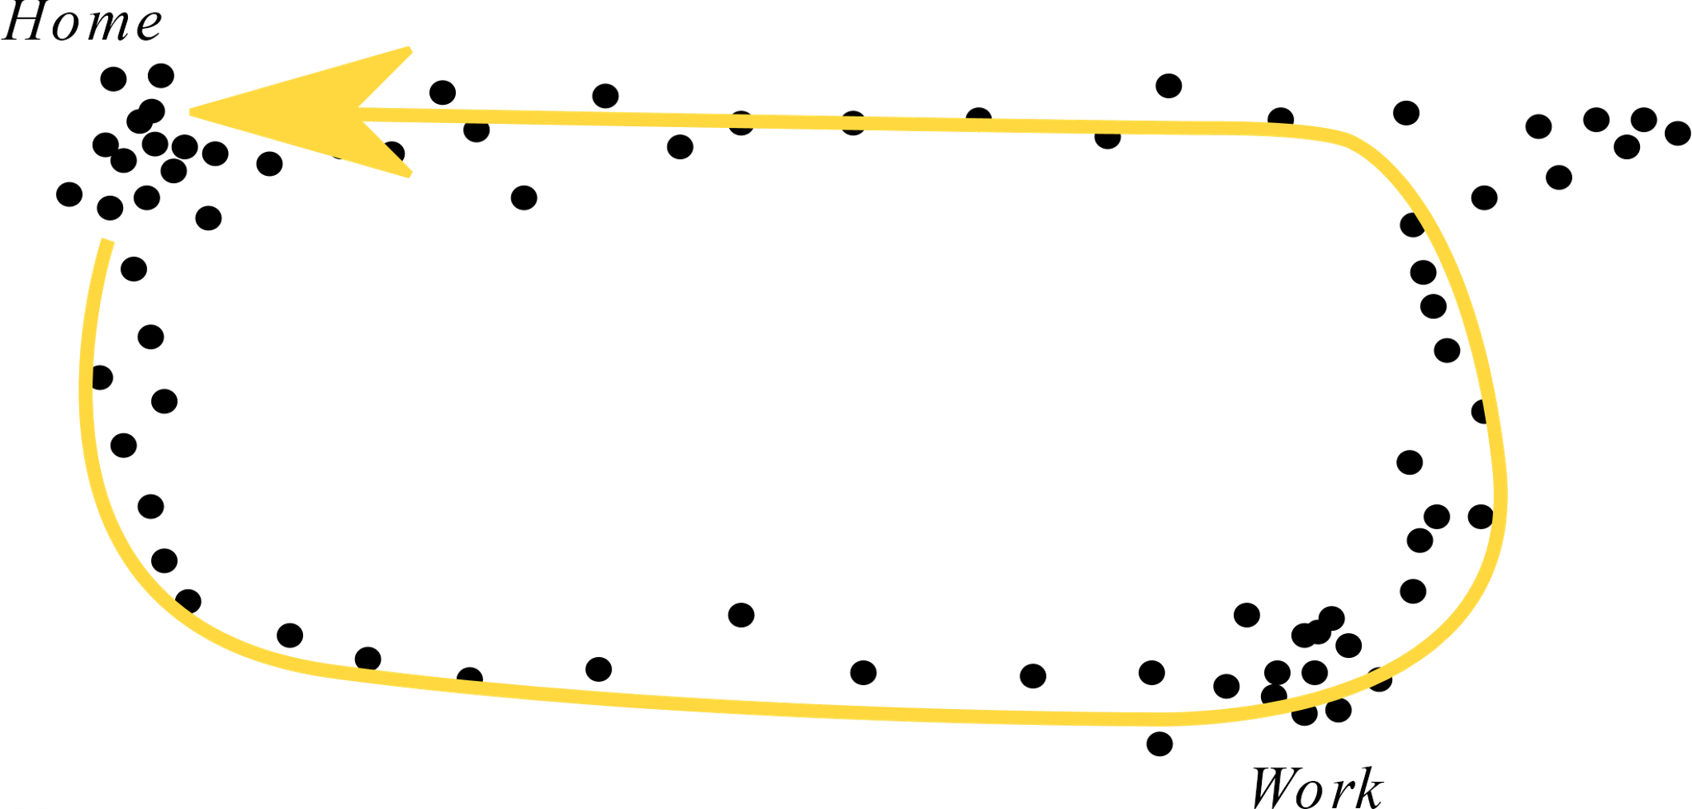
Mobility traces
Notes:
Explain what is a mobility trace?
What is a point? – Point captured by some sensor
Mobility traces (points)
Idea: Infer Information

Slide 7
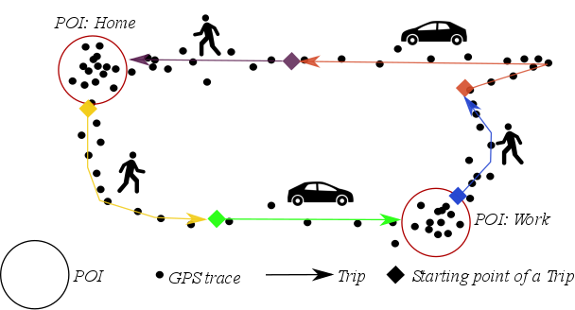
Information

Slide 8
Data from sensors
GPS records
Acceleration
Latitude
X, Y, Z components of
instantaneous acceleration
Longitude
Altitude
Wifi
Timestamp
Accuracy
MAC address
Speed
Signal Strength
Bearing
SSID (Name of the network)
etc
Timestamp
Notes:
Data capture from mobile phone sensors are:
GPS records: explain what is a gps signal
Acceleration: vector in 3D
Wifi scan: explain what is a wifi scan

Slide 9
State of the Art
Notes:
Don’t go into detail of each an every one

Slide 10
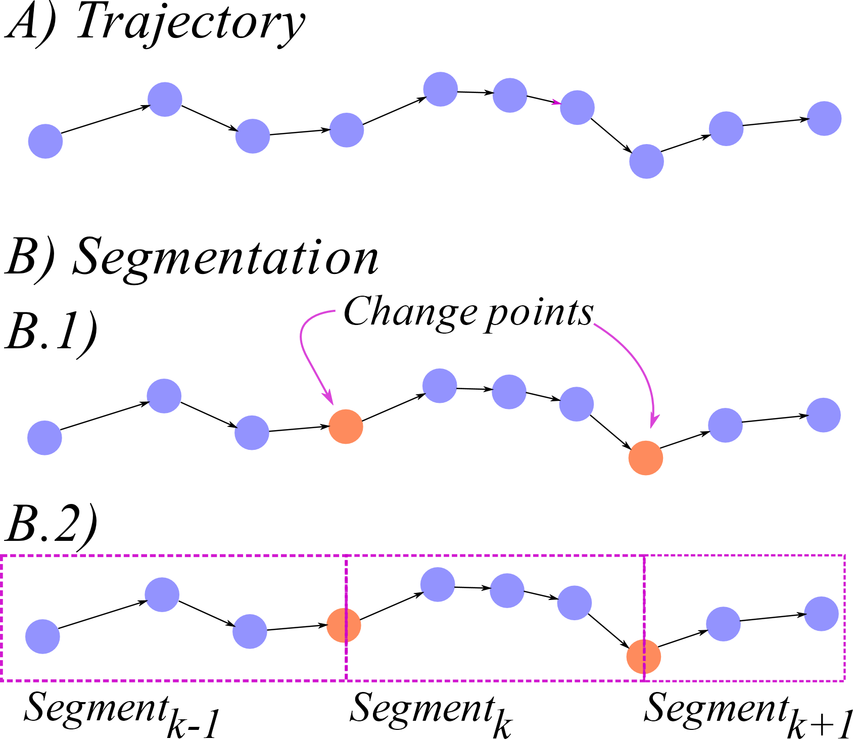
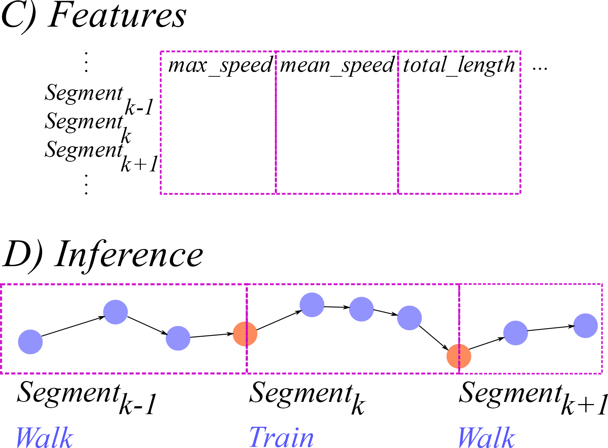
Workflow
Notes:
Traditional processing of mobility traces for inference of transport mode

Slide 11
State of the art
Paper | Workflow | Modes | Data from
[Zheng et al., 2008] | Pre-processing | Walking | GPS
Learning transportation | Segmentation | Biking
mode from raw gps data | Decision Tree | Car
for geographic applications | Post-processing | Bus
on the web
[Schussler and Axhausen, 2009] | Pre-processing | Walking | GPS
Processing GPS raw data | Trip and Activity | Biking
without additional | detection | Car
information | Mode detection | Rail
 | Post Processing | Urban Public
[Bolbol et al., 2012] | Pre-processing | Walking | GPS
Inferring hybrid | SVM over sliding | Biking
transportation modes from | window | Bus
sparse GPS data using a | Post-processing | Car
moving window SVM |  | Train
classification |  | Underground
[Tsui and Shalaby, 2006] | Pre-processing | Bus | GPS
Enhanced system for Link | Trip and Activity | Car | and
and Mode Identification for | detection | Biking | GIS (optional)
Personal Travel Surveys | Segmentation | Stationary
Based on Global Positioning | Fuzzy inference | Walking
Systems | Post-processing
Notes:
SOTA: State of the art

Slide 12
Paper | Workflow | Modes | Data from
[Dalumpines and Scott, 2017] | Pre-processing | Stop | GPS
Making mode detection | Segmentation | Walking
transferrable: extracting | into "episodes" | Car
activity and travel episodes | Multinomial Logit | Bus
from gps data using |  | Other
multinomial logit model
and python
[Zong et al., 2015] | Pre-processing | Walking | GPS
Identifying travel mode | Segmentation | Biking
with gps data using support | SVC Classification | Car
vector machines and genetic |  | Subway
algorithm |  | Bus
 |  | Other
[Reddy et al., 2010] | Pre-processing | Stop | GPS
Using mobile phones to | Feature Extraction | Walking | and
determine transportation | over sliding window | Running | Accelerometer
modes | Decision Tree | Biking
 | DHMM | Motorized
[Wang et al., 2010] | Pre-processing | Bicycle | Accelerometer
Accelerometer based | Feature Extraction | Bus
transportation mode | over sliding window | Car
recognition on mobile | Decision Tree | Stationary
phones |  | Subway
 |  | Walking
[Hemminki et al., 2013] | Pre-processing | Train | Accelerometer
Accelerometer based | Feature Extraction | Bus
transportation mode | over sliding window | Stationary
detection on smartphones | Adaboost with | Metro
 | trees with depth 2 | Tram
 | or 1 | Car
Notes:
There are many contributions, and they differ in the modes used in detection, sensor data used and the general worklow of processing used

Slide 13
Available data set
Geolife data set
Public
12,517,364 GPS records
Used in [Zheng et al., 2008]
3,283,527 labeled
178 Users
April 2007 to October 2011
Notes:
Difficul to reproduce
Available datasets
Only geollife

Slide 14
Available data set
Naive Bayes
 | Predicted
Actual | car | walk | bus | bike |  |  | car |  | walk |  | bus |  | bike
car | 9 | 10 | 191 | 23 | 233 |  | 0,32 | 0,04 | 0,03 | 0,04 | 0,49 | 0,82 | 0,05 | 0,10
walk | 10 | 296 | 30 | 190 | 526 |  | 0,36 | 0,02 | 0,91 | 0,56 | 0,08 | 0,06 | 0,45 | 0,36
bus | 5 | 16 | 144 | 64 | 229 |  | 0,18 | 0,02 | 0,05 | 0,07 | 0,37 | 0,63 | 0,15 | 0,28
bike | 4 | 3 | 24 | 145 | 176 |  | 0,14 | 0,02 | 0,01 | 0,02 | 0,06 | 0,14 | 0,34 | 0,82
 | 28 | 325 | 389 | 422
 |  |  |  |  |  |  | car |  | walk |  | bus |  | bike
 |  |  |  |  |  |  | Precision | Recall | Precision | Recall | Precision | Recall | Precision | Recall
 |  |  |  |  |  |  | 0,32 | 0,04 | 0,91 | 0,56 | 0,37 | 0,63 | 0,34 | 0,82
 |  |  |  |  |  |  | avg Pr | 0,49
 |  |  |  |  |  |  | avg Re | 0,51
Notes:
Explain the confusión matrix, the metrics Precision and Recall

Slide 15
Available data set
Bayes Network
 | Predicted
Actual | car | walk | bus | bike |  |  | car |  | walk |  | bus |  | bike
car | 155 | 15 | 53 | 10 | 233 |  | 0,81 | 0,67 | 0,03 | 0,06 | 0,17 | 0,23 | 0,05 | 0,04
walk | 4 | 393 | 66 | 63 | 526 |  | 0,02 | 0,01 | 0,87 | 0,75 | 0,21 | 0,13 | 0,31 | 0,12
bus | 31 | 15 | 162 | 21 | 229 |  | 0,16 | 0,14 | 0,03 | 0,07 | 0,50 | 0,71 | 0,10 | 0,09
bike | 1 | 27 | 40 | 108 | 176 |  | 0,01 | 0,01 | 0,06 | 0,15 | 0,12 | 0,23 | 0,53 | 0,61
 | 191 | 450 | 321 | 202
 |  |  |  |  |  |  | car |  | walk |  | bus |  | bike
 |  |  |  |  |  |  | Precision | Recall | Precision | Recall | Precision | Recall | Precision | Recall
 |  |  |  |  |  |  | 0,81 | 0,67 | 0,87 | 0,75 | 0,50 | 0,71 | 0,53 | 0,61
 |  |  |  |  |  |  | avg Pr | 0,68
 |  |  |  |  |  |  | avg Re | 0,68
Notes:
Explain the confusión matrix, the metrics Precision and Recall

Slide 16
Available data set
Decision Tree
 | Predicted
Actual | car | walk | bus | bike |  |  | car |  | walk |  | bus |  | bike
car | 174 | 12 | 38 | 9 | 233 |  | 0,81 | 0,75 | 0,02 | 0,05 | 0,16 | 0,16 | 0,05 | 0,04
walk | 6 | 493 | 16 | 11 | 526 |  | 0,03 | 0,01 | 0,90 | 0,94 | 0,07 | 0,03 | 0,06 | 0,02
bus | 32 | 21 | 165 | 11 | 229 |  | 0,15 | 0,14 | 0,04 | 0,09 | 0,70 | 0,72 | 0,06 | 0,05
bike | 2 | 19 | 16 | 139 | 176 |  | 0,01 | 0,01 | 0,03 | 0,11 | 0,07 | 0,09 | 0,82 | 0,79
 | 214 | 545 | 235 | 170
 |  |  |  |  |  |  | car |  | walk |  | bus |  | bike
 |  |  |  |  |  |  | Precision | Recall | Precision | Recall | Precision | Recall | Precision | Recall
 |  |  |  |  |  |  | 0,81 | 0,75 | 0,90 | 0,94 | 0,70 | 0,72 | 0,82 | 0,79
 |  |  |  |  |  |  | avg Pr | 0,81
 |  |  |  |  |  |  | avg Re | 0,80
Notes:
Explain the confusión matrix, the metrics Precision and Recall

Slide 17
Available data set
Results
Decision tree: best method
Recall
0.80 vs 0.887 [Zheng et al. 2008]
Precision
0.81 vs 0.406 [Zheng et al. 2008]
Notes:
Difficul to reproduce but some similar results

Slide 18
Work Done

Slide 19
Work Done
Data Collection
GUI
POI detection
Mode detection
Notes:
Outline of the work done:
Data collection
GUI
Activity detection (leverage)
Mode detection

Slide 20
Data Collection
Apisense Bee
Android app developed by colleagues in Lille
Records sensors data
Configurable
json
Notes:
Tool for data collection: API sense Application, from colleagues from Lille
Put logo of Bee

Slide 21
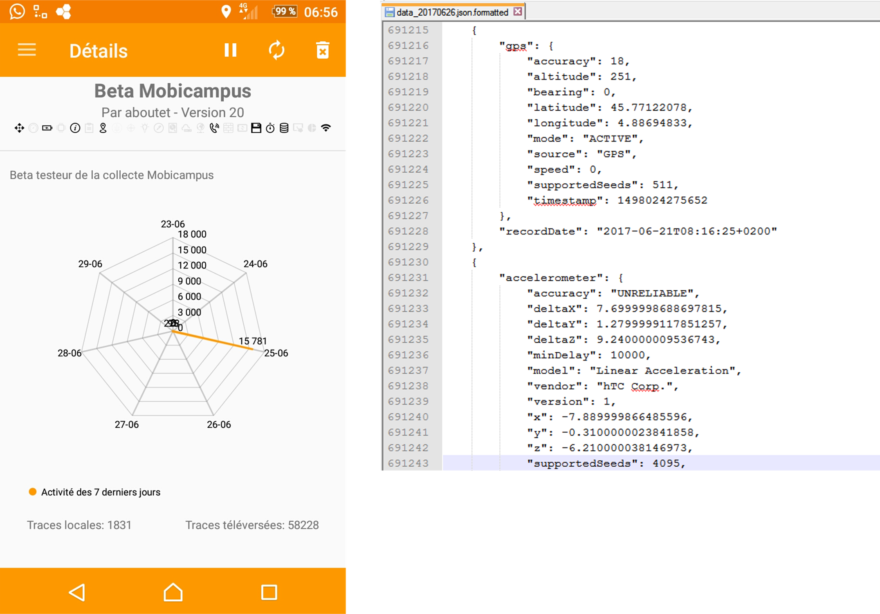
Data Collection
Notes:
Tool for data collection: API sense Application, from colleagues from Lille
Capture of data and show data format examples

Slide 22
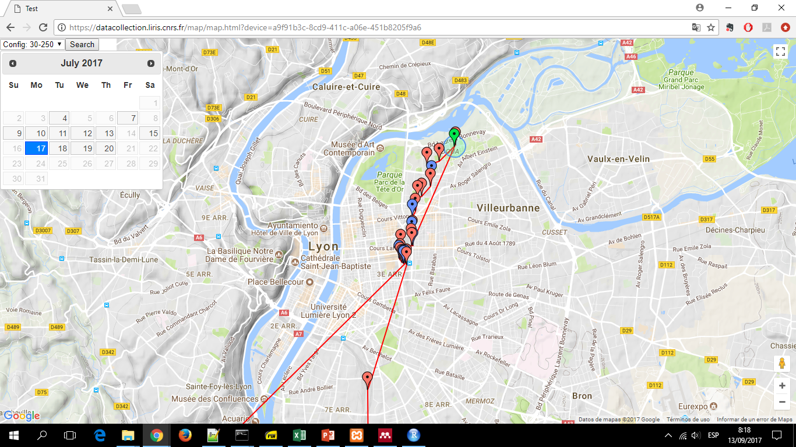
GUI
Notes:
The GUI shows information for validation, it shows the POIs, a context search, trajectory and aditional info

Slide 23
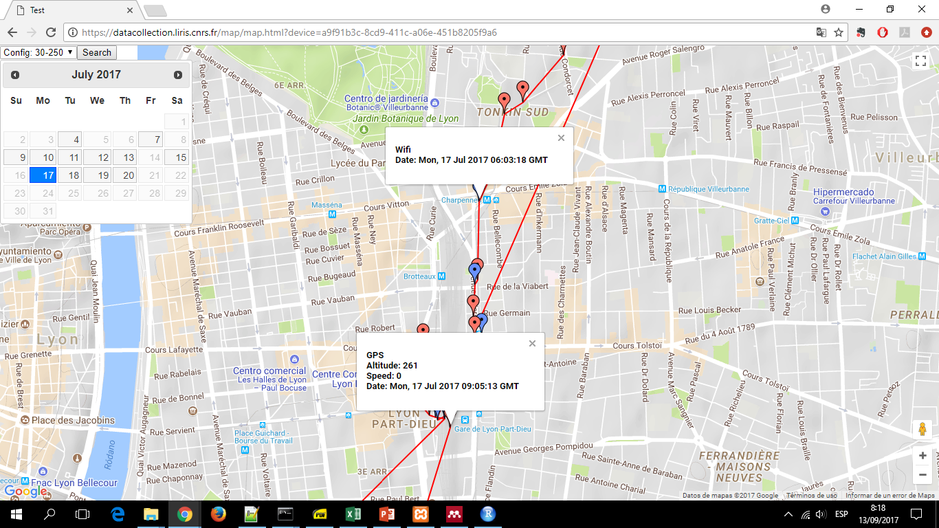
GUI
Notes:
The GUI shows information for validation, it shows the POIs, a context search, trajectory and aditional info

Slide 24
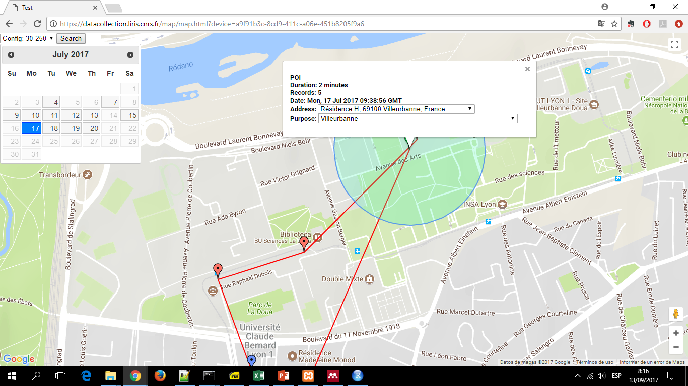
GUI
Notes:
The GUI shows information for validation, it shows the POIs, a context search, trajectory and aditional info

Slide 25
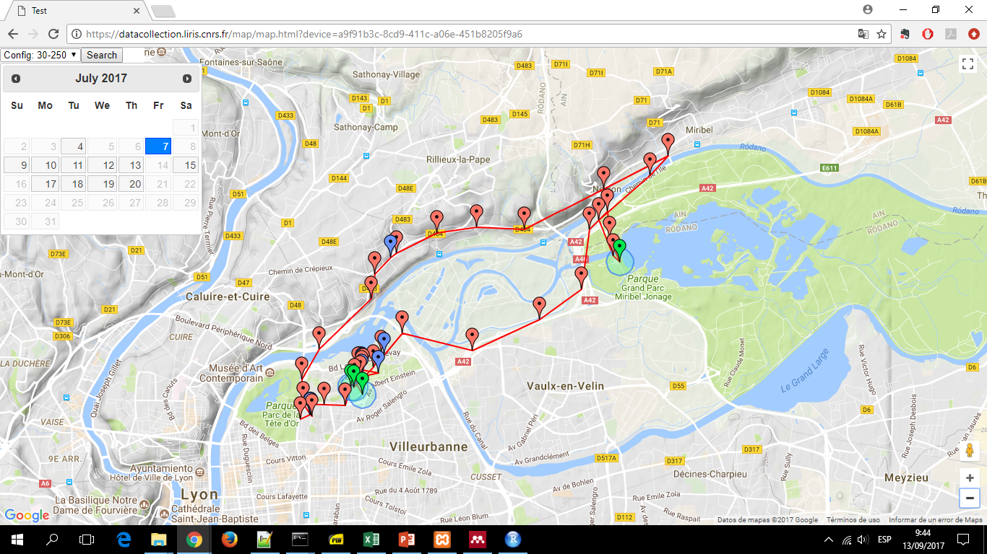
GUI
Notes:
Example of a trajectory

Slide 26
POI detection

Slide 27
POI detection
Parameterized by
Maximum distance $diameter δ$
Minimum stay time $τ$ (duration)
Notes:
Mention the algorithm developed in the lab
When the user stays more than tao (duration) min inside an área of diameter delta (distance)
etc

Slide 28
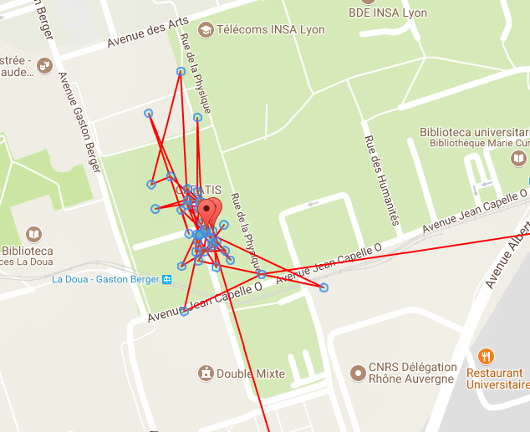
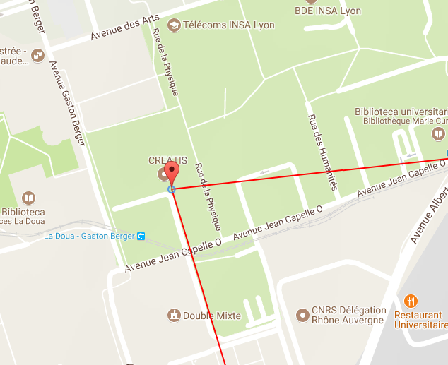
POI detection
δ = 20 mts
τ = 30 min
δ = 200 mts
τ = 30 min
Notes:
These are too extreme examples with delta 20 mts and 200 mts, we see in the right that all those points are clustered
In the POI found

Slide 29
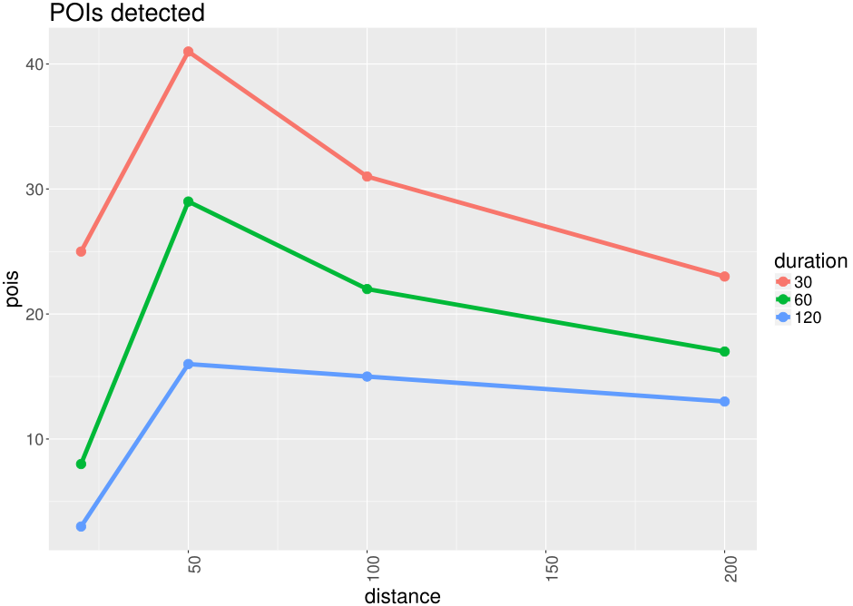
POI detection
Notes:
So in order to find good values for tao and delta we did some sensititvity analysis varying both parameter
In the left we see in the x axis the distance parameter in mts on the y axis is the number of pois, and with different
Color we plot the duration parameter

Slide 30
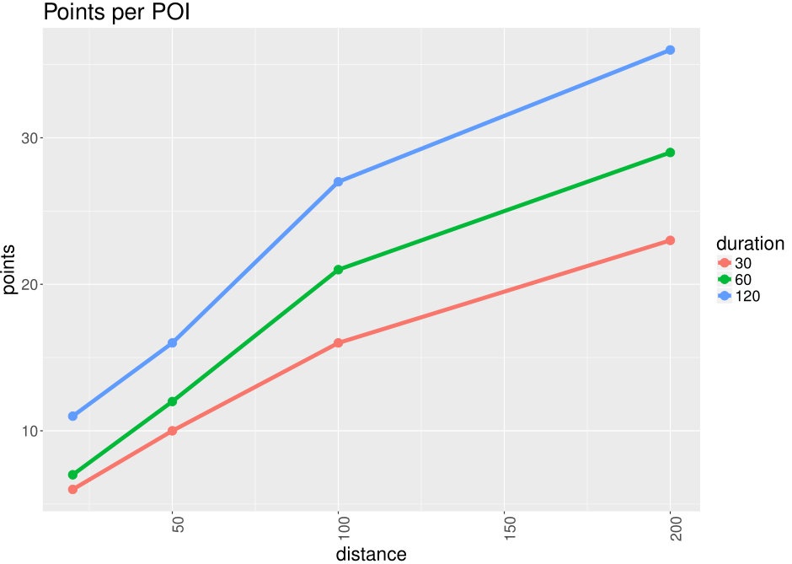
POI detection
Notes:
So in order to find good values for tao and delta I did some sensititvity analysis varying both parameter
In the left we see in the x axis the distance parameter in mts on the y axis is the number of pois, and with different
Color we plot the duration parameter

Slide 31
Mode Detection
Notes:
Finally we did some experiments with captured data

Slide 32
Distribution of acceleration traces
Notes:
First with acceleration data
Sample rate of 30 Hertz
Window of 2 sec

Slide 33
Workflow

Slide 34
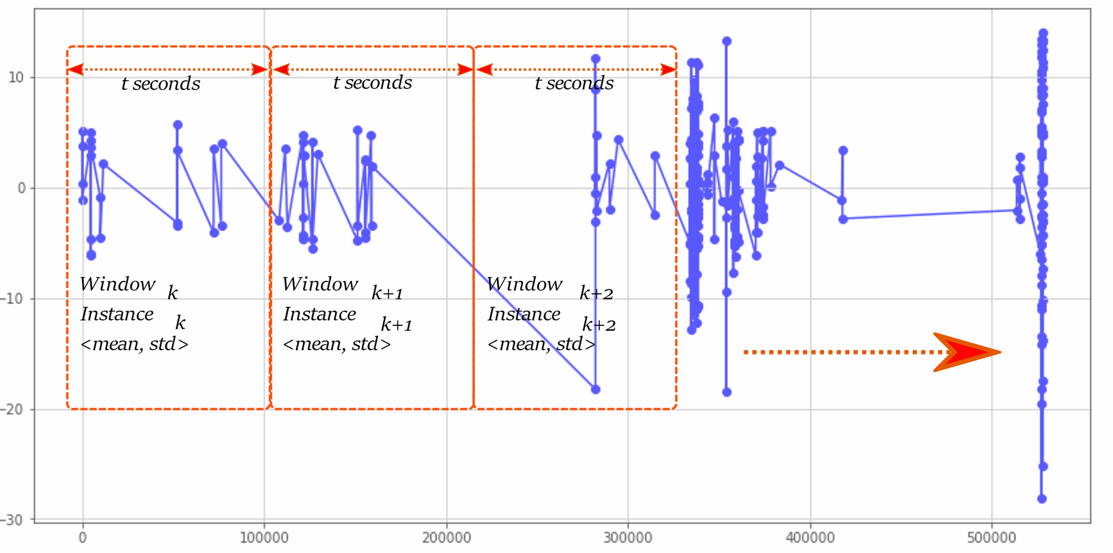
Acceleration
Notes:
Processing of acceleration signals

Slide 35
Experiment 1
Acceleration based detection
Data: car 13507, train 1268, tramway 2732, walk 8343
Sample rate 30 Hz
Window: 2 sec
Methods: decision trees, support vector classifier, random forest, gradient boosting
Notes:
Window of 2 sec

Slide 36
Using statistical features
Decision tree
 | Predicted
Actual | car | train | tram | walk |  |  | car |  | train |  | tram |  | walk
car | 4531 | 264 | 159 | 14 | 4968 |  | 0,90 | 0,91 | 0,16 | 0,05 | 0,22 | 0,03 | 0,01 | 0,00
train | 254 | 1309 | 27 | 4 | 1594 |  | 0,05 | 0,16 | 0,80 | 0,82 | 0,04 | 0,02 | 0,00 | 0,00
tram | 226 | 46 | 509 | 14 | 795 |  | 0,04 | 0,28 | 0,03 | 0,06 | 0,72 | 0,64 | 0,01 | 0,02
walk | 22 | 11 | 13 | 1174 | 1220 |  | 0,00 | 0,02 | 0,01 | 0,01 | 0,02 | 0,01 | 0,97 | 0,96
 | 5033 | 1630 | 708 | 1206
 |  |  |  |  |  |  | car |  | train |  | tram |  | walk
 |  |  |  |  |  |  | Precision | Recall | Precision | Recall | Precision | Recall | Precision | Recall
 |  |  |  |  |  |  | 0,90 | 0,91 | 0,80 | 0,82 | 0,72 | 0,64 | 0,97 | 0,96
 |  |  |  |  |  |  | avg Pr | 0,85
 |  |  |  |  |  |  | avg Re | 0,83
Notes:
Results using statistical features

Slide 37
Using statistical features
Support vector classifier
 | Predicted
Actual | car | train | tram | walk |  |  | car |  | train |  | tram |  | walk
car | 4480 | 317 | 140 | 31 | 4968 |  | 0,82 | 0,90 | 0,23 | 0,06 | 0,24 | 0,03 | 0,03 | 0,01
train | 509 | 1000 | 63 | 22 | 1594 |  | 0,09 | 0,32 | 0,73 | 0,63 | 0,11 | 0,04 | 0,02 | 0,01
tram | 368 | 42 | 375 | 10 | 795 |  | 0,07 | 0,46 | 0,03 | 0,05 | 0,64 | 0,47 | 0,01 | 0,01
walk | 129 | 9 | 4 | 1078 | 1220 |  | 0,02 | 0,11 | 0,01 | 0,01 | 0,01 | 0,00 | 0,94 | 0,88
 | 5486 | 1368 | 582 | 1141
 |  |  |  |  |  |  | car |  | train |  | tram |  | walk
 |  |  |  |  |  |  | Precision | Recall | Precision | Recall | Precision | Recall | Precision | Recall
 |  |  |  |  |  |  | 0,82 | 0,90 | 0,73 | 0,63 | 0,64 | 0,47 | 0,94 | 0,88
 |  |  |  |  |  |  | avg Pr | 0,78
 |  |  |  |  |  |  | avg Re | 0,72
Notes:
Results using statistical features

Slide 38
Using statistical features
Random Forest
 | Predicted
Actual | car | train | tram | walk |  |  | car |  | train |  | tram |  | walk
car | 4851 | 99 | 4 | 14 | 4968 |  | 0,88 | 0,98 | 0,07 | 0,02 | 0,01 | 0,00 | 0,01 | 0,00
train | 327 | 1262 | 4 | 1 | 1594 |  | 0,06 | 0,21 | 0,91 | 0,79 | 0,01 | 0,00 | 0,00 | 0,00
tram | 289 | 17 | 468 | 21 | 795 |  | 0,05 | 0,36 | 0,01 | 0,02 | 0,98 | 0,59 | 0,02 | 0,03
walk | 15 | 5 | 2 | 1198 | 1220 |  | 0,00 | 0,01 | 0,00 | 0,00 | 0,00 | 0,00 | 0,97 | 0,98
 | 5482 | 1383 | 478 | 1234
 |  |  |  |  |  |  | car |  | train |  | tram |  | walk
 |  |  |  |  |  |  | Precision | Recall | Precision | Recall | Precision | Recall | Precision | Recall
 |  |  |  |  |  |  | 0,88 | 0,98 | 0,91 | 0,79 | 0,98 | 0,59 | 0,97 | 0,98
 |  |  |  |  |  |  | avg Pr | 0,94
 |  |  |  |  |  |  | avg Re | 0,83
Notes:
Results using statistical features

Slide 39
Using statistical features
Gradient Boosting
 | Predicted
Actual | car | train | tram | walk |  |  | car |  | train |  | tram |  | walk
car | 4832 | 111 | 14 | 11 | 4968 |  | 0,89 | 0,97 | 0,08 | 0,02 | 0,03 | 0,00 | 0,01 | 0,00
train | 300 | 1287 | 6 | 1 | 1594 |  | 0,06 | 0,19 | 0,90 | 0,81 | 0,01 | 0,00 | 0,00 | 0,00
tram | 268 | 23 | 486 | 18 | 795 |  | 0,05 | 0,34 | 0,02 | 0,03 | 0,95 | 0,61 | 0,01 | 0,02
walk | 16 | 7 | 7 | 1190 | 1220 |  | 0,00 | 0,01 | 0,00 | 0,01 | 0,01 | 0,01 | 0,98 | 0,98
 | 5416 | 1428 | 513 | 1220
 |  |  |  |  |  |  | car |  | train |  | tram |  | walk
 |  |  |  |  |  |  | Precision | Recall | Precision | Recall | Precision | Recall | Precision | Recall
 |  |  |  |  |  |  | 0,89 | 0,97 | 0,90 | 0,81 | 0,95 | 0,61 | 0,98 | 0,98
 |  |  |  |  |  |  | avg Pr | 0,93
 |  |  |  |  |  |  | avg Re | 0,84
Notes:
Results using statistical features

Slide 40
Using frequency domain features
Decision tree
 | Predicted
Actual | car | train | tram | walk |  |  | car |  | train |  | tram |  | walk
car | 4575 | 290 | 77 | 26 | 4968 |  | 0,83 | 0,92 | 0,22 | 0,06 | 0,15 | 0,02 | 0,02 | 0,01
train | 574 | 920 | 77 | 23 | 1594 |  | 0,10 | 0,36 | 0,70 | 0,58 | 0,15 | 0,05 | 0,02 | 0,01
tram | 332 | 66 | 345 | 52 | 795 |  | 0,06 | 0,42 | 0,05 | 0,08 | 0,65 | 0,43 | 0,04 | 0,07
walk | 26 | 38 | 30 | 1126 | 1220 |  | 0,00 | 0,02 | 0,03 | 0,03 | 0,06 | 0,02 | 0,92 | 0,92
 | 5507 | 1314 | 529 | 1227
 |  |  |  |  |  |  | car |  | train |  | tram |  | walk
 |  |  |  |  |  |  | Precision | Recall | Precision | Recall | Precision | Recall | Precision | Recall
 |  |  |  |  |  |  | 0,83 | 0,92 | 0,70 | 0,58 | 0,65 | 0,43 | 0,92 | 0,92
 |  |  |  |  |  |  | avg Pr | 0,78
 |  |  |  |  |  |  | avg Re | 0,71
Notes:
Results using frequency domain features

Slide 41
Using frequency domain features
Support vector classifier
 | Predicted
Actual | car | train | tram | walk |  |  | car |  | train |  | tram |  | walk
car | 4388 | 496 | 68 | 16 | 4968 |  | 0,76 | 0,88 | 0,34 | 0,10 | 0,17 | 0,01 | 0,02 | 0,00
train | 808 | 702 | 51 | 33 | 1594 |  | 0,14 | 0,51 | 0,48 | 0,44 | 0,13 | 0,03 | 0,03 | 0,02
tram | 393 | 186 | 198 | 18 | 795 |  | 0,07 | 0,49 | 0,13 | 0,23 | 0,49 | 0,25 | 0,02 | 0,02
walk | 160 | 82 | 87 | 891 | 1220 |  | 0,03 | 0,13 | 0,06 | 0,07 | 0,22 | 0,07 | 0,93 | 0,73
 | 5749 | 1466 | 404 | 958
 |  |  |  |  |  |  | car |  | train |  | tram |  | walk
 |  |  |  |  |  |  | Precision | Recall | Precision | Recall | Precision | Recall | Precision | Recall
 |  |  |  |  |  |  | 0,76 | 0,88 | 0,48 | 0,44 | 0,49 | 0,25 | 0,93 | 0,73
 |  |  |  |  |  |  | avg Pr | 0,67
 |  |  |  |  |  |  | avg Re | 0,58
Notes:
Results using frequency domain features

Slide 42
Using frequency domain features
Random Forest
 | Predicted
Actual | car | train | tram | walk |  |  | car |  | train |  | tram |  | walk
car | 4707 | 201 | 36 | 24 | 4968 |  | 0,84 | 0,95 | 0,16 | 0,04 | 0,08 | 0,01 | 0,02 | 0,00
train | 575 | 944 | 50 | 25 | 1594 |  | 0,10 | 0,36 | 0,76 | 0,59 | 0,12 | 0,03 | 0,02 | 0,02
tram | 329 | 76 | 339 | 51 | 795 |  | 0,06 | 0,41 | 0,06 | 0,10 | 0,78 | 0,43 | 0,04 | 0,06
walk | 21 | 21 | 9 | 1169 | 1220 |  | 0,00 | 0,02 | 0,02 | 0,02 | 0,02 | 0,01 | 0,92 | 0,96
 | 5632 | 1242 | 434 | 1269
 |  |  |  |  |  |  | car |  | train |  | tram |  | walk
 |  |  |  |  |  |  | Precision | Recall | Precision | Recall | Precision | Recall | Precision | Recall
 |  |  |  |  |  |  | 0,84 | 0,95 | 0,76 | 0,59 | 0,78 | 0,43 | 0,92 | 0,96
 |  |  |  |  |  |  | avg Pr | 0,82
 |  |  |  |  |  |  | avg Re | 0,73
Notes:
Results using frequency domain features

Slide 43
Using frequency domain features
Gradient Boosting
 | Predicted
Actual | car | train | tram | walk |  |  | car |  | train |  | tram |  | walk
car | 4683 | 225 | 46 | 14 | 4968 |  | 0,83 | 0,94 | 0,18 | 0,05 | 0,10 | 0,01 | 0,01 | 0,00
train | 605 | 925 | 42 | 22 | 1594 |  | 0,11 | 0,38 | 0,74 | 0,58 | 0,09 | 0,03 | 0,02 | 0,01
tram | 320 | 78 | 349 | 48 | 795 |  | 0,06 | 0,40 | 0,06 | 0,10 | 0,77 | 0,44 | 0,04 | 0,06
walk | 26 | 28 | 15 | 1151 | 1220 |  | 0,00 | 0,02 | 0,02 | 0,02 | 0,03 | 0,01 | 0,93 | 0,94
 | 5634 | 1256 | 452 | 1235
 |  |  |  |  |  |  | car |  | train |  | tram |  | walk
 |  |  |  |  |  |  | Precision | Recall | Precision | Recall | Precision | Recall | Precision | Recall
 |  |  |  |  |  |  | 0,83 | 0,94 | 0,74 | 0,58 | 0,77 | 0,44 | 0,93 | 0,94
 |  |  |  |  |  |  | avg Pr | 0,82
 |  |  |  |  |  |  | avg Re | 0,73
Notes:
Results using frequency domain features

Slide 44
Experiment 2
Add speed from GPS records
Notes:
Add speed from gps sensor

Slide 45
Experiment 2
Notes:
Explain plot x axis = window size
Y = precisión or recall
For each class

Slide 46
Experiment 2
Notes:
Explain plot x axis = window size
Y = precisión or recall
For each class

Slide 47
Experiment 2
Decision tree
 | Predicted
Actual | car | train | tram | walk |  |  | car |  | train |  | tram |  | walk
car | 9718 | 106 | 26 | 6 | 9856 |  | 0,98 | 0,99 | 0,03 | 0,01 | 0,02 | 0,00 | 0,00 | 0,00
train | 150 | 3025 | 81 | 9 | 3265 |  | 0,02 | 0,05 | 0,94 | 0,93 | 0,06 | 0,02 | 0,00 | 0,00
tram | 63 | 85 | 1333 | 5 | 1486 |  | 0,01 | 0,04 | 0,03 | 0,06 | 0,92 | 0,90 | 0,00 | 0,00
walk | 3 | 18 | 11 | 2510 | 2542 |  | 0,00 | 0,00 | 0,01 | 0,01 | 0,01 | 0,00 | 0,99 | 0,99
 | 9934 | 3234 | 1451 | 2530
 |  |  |  |  |  |  | car |  | train |  | tram |  | walk
 |  |  |  |  |  |  | Precision | Recall | Precision | Recall | Precision | Recall | Precision | Recall
 |  |  |  |  |  |  | 0,98 | 0,99 | 0,94 | 0,93 | 0,92 | 0,90 | 0,99 | 0,99
 |  |  |  |  |  |  | avg Pr | 0,96
 |  |  |  |  |  |  | avg Re | 0,95

Slide 48
Experiment 2
Support vector classifier
 | Predicted
Actual | car | train | tram | walk |  |  | car |  | train |  | tram |  | walk
car | 9329 | 507 | 19 | 1 | 9856 |  | 0,91 | 0,95 | 0,15 | 0,05 | 0,02 | 0,00 | 0,00 | 0,00
train | 459 | 2724 | 77 | 5 | 3265 |  | 0,04 | 0,14 | 0,78 | 0,83 | 0,07 | 0,02 | 0,00 | 0,00
tram | 263 | 183 | 1036 | 4 | 1486 |  | 0,03 | 0,18 | 0,05 | 0,12 | 0,91 | 0,70 | 0,00 | 0,00
walk | 256 | 59 | 5 | 2222 | 2542 |  | 0,02 | 0,10 | 0,02 | 0,02 | 0,00 | 0,00 | 1,00 | 0,87
 | 10307 | 3473 | 1137 | 2232
 |  |  |  |  |  |  | car |  | train |  | tram |  | walk
 |  |  |  |  |  |  | Precision | Recall | Precision | Recall | Precision | Recall | Precision | Recall
 |  |  |  |  |  |  | 0,91 | 0,95 | 0,78 | 0,83 | 0,91 | 0,70 | 1,00 | 0,87
 |  |  |  |  |  |  | avg Pr | 0,90
 |  |  |  |  |  |  | avg Re | 0,84

Slide 49
Experiment 2
Random Forest
 | Predicted
Actual | car | train | tram | walk |  |  | car |  | train |  | tram |  | walk
car | 9670 | 116 | 42 | 28 | 9856 |  | 0,97 | 0,98 | 0,04 | 0,01 | 0,03 | 0,00 | 0,01 | 0,00
train | 247 | 2879 | 121 | 18 | 3265 |  | 0,02 | 0,08 | 0,92 | 0,88 | 0,08 | 0,04 | 0,01 | 0,01
tram | 64 | 104 | 1293 | 25 | 1486 |  | 0,01 | 0,04 | 0,03 | 0,07 | 0,88 | 0,87 | 0,01 | 0,02
walk | 10 | 18 | 10 | 2504 | 2542 |  | 0,00 | 0,00 | 0,01 | 0,01 | 0,01 | 0,00 | 0,97 | 0,99
 | 9991 | 3117 | 1466 | 2575
 |  |  |  |  |  |  | car |  | train |  | tram |  | walk
 |  |  |  |  |  |  | Precision | Recall | Precision | Recall | Precision | Recall | Precision | Recall
 |  |  |  |  |  |  | 0,97 | 0,98 | 0,92 | 0,88 | 0,88 | 0,87 | 0,97 | 0,99
 |  |  |  |  |  |  | avg Pr | 0,94
 |  |  |  |  |  |  | avg Re | 0,93

Slide 50
Experiment 2
Gradient Boosting
 | Predicted
Actual | car | train | tram | walk |  |  | car |  | train |  | tram |  | walk
car | 9765 | 70 | 20 | 1 | 9856 |  | 0,99 | 0,99 | 0,02 | 0,01 | 0,01 | 0,00 | 0,00 | 0,00
train | 112 | 3073 | 71 | 9 | 3265 |  | 0,01 | 0,03 | 0,94 | 0,94 | 0,05 | 0,02 | 0,00 | 0,00
tram | 29 | 96 | 1355 | 6 | 1486 |  | 0,00 | 0,02 | 0,03 | 0,06 | 0,93 | 0,91 | 0,00 | 0,00
walk | 4 | 13 | 10 | 2515 | 2542 |  | 0,00 | 0,00 | 0,00 | 0,01 | 0,01 | 0,00 | 0,99 | 0,99
 | 9910 | 3252 | 1456 | 2531
 |  |  |  |  |  |  | car |  | train |  | tram |  | walk
 |  |  |  |  |  |  | Precision | Recall | Precision | Recall | Precision | Recall | Precision | Recall
 |  |  |  |  |  |  | 0,99 | 0,99 | 0,94 | 0,94 | 0,93 | 0,91 | 0,99 | 0,99
 |  |  |  |  |  |  | avg Pr | 0,96
 |  |  |  |  |  |  | avg Re | 0,96

Slide 51
Distribution of acceleration traces

Slide 52
Conclusions
Notes:
And finally some conclusions

Slide 53
Conclusions
Challenges
Collecting and labeling data
Generalization
Fine grain labeling (difficult)
Notes:
Problems

Slide 54
Conclusions
To do
Leverage on bigger datasets (Privamov)
Try unsupervised learning
Add context information (Example: stops, train lines)
Notes:
Next steps

Slide 55
Thanks

Slide 56
Appendix

Slide 57
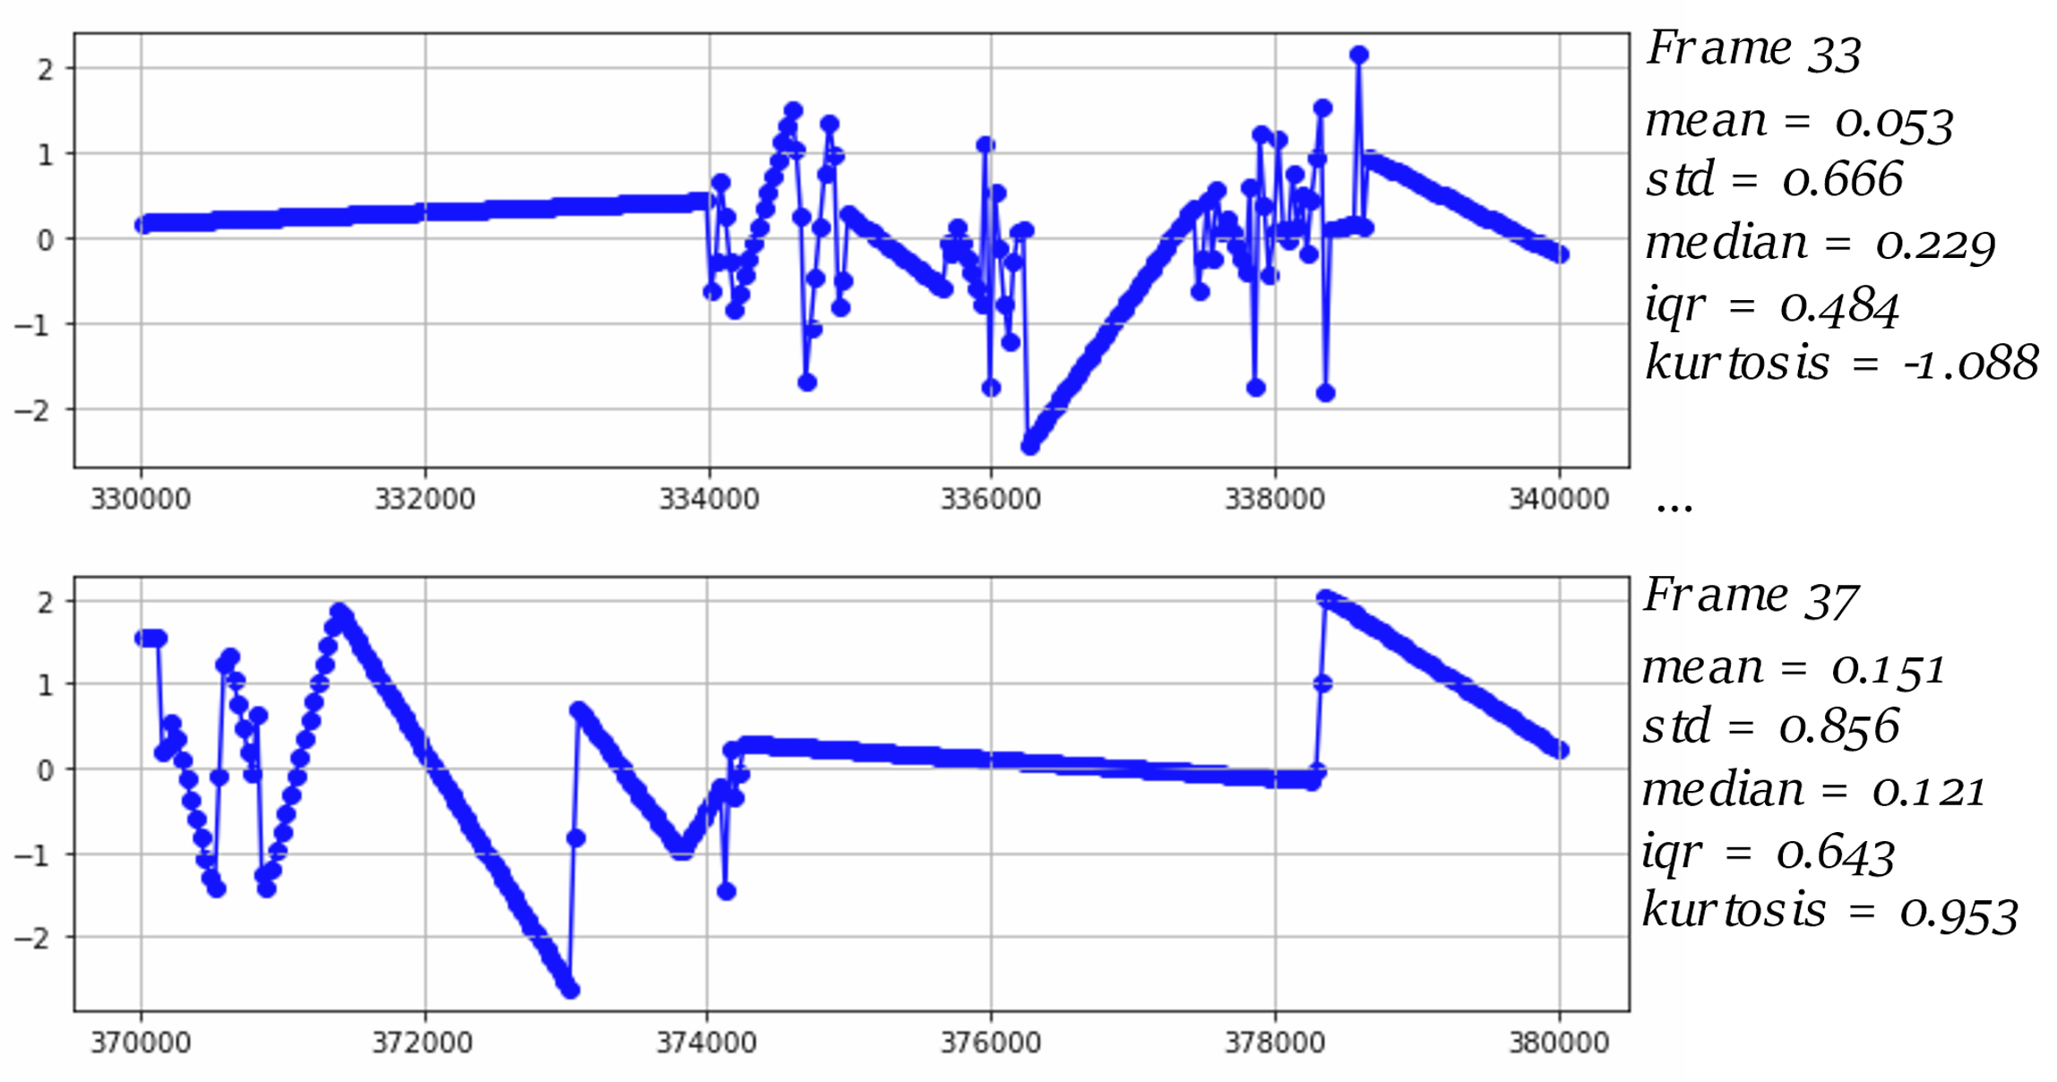
Mode detection
Acceleration
Parameterized by
Sliding window
Sample rate

Slide 58
Experiment 1
Features Group 1: Statistical
f1_max_acc: Max acceleration
f1_mean_acc: Mean acceleration
f1_median_acc: Median
f1_min_acc: Min
f1_std_acc: Standard deviation
f2_max_dacc: Max of the difference

Slide 59
Experiment 1
Features Group 1: Statistical
f2_mean_dacc: Mean of the difference
f2_median_dacc: Median of the difference
f2_min_dacc: Min of the difference
f2_std_dacc: Standard deviation of the difference

Slide 60
Experiment 1
Features Group 2: Statistical + FFT
f1_max_acc: Max acceleration
f1_mean_acc: Mean acceleration
f1_min_acc: Min
f1_std_acc: Standard deviation

Slide 61
Experiment 1
Features Group 2: Statistical + FFT
f3_abs_fft_1hz: FFT magnitude at 1 Hz
f3_abs_fft_2hz: FFT magnitude at 2 Hz
f3_abs_fft_3hz: FFT magnitude at 3 Hz

Slide 62
Experiment 2
Adding speed
Notes:
Gps speed histogram per class

Slide 63
Experiment 2
How to combine

Slide 64
Experiment 2
Features
f1_max_acc: Max acceleration
f1_mean_acc: Mean acceleration
f1_min_acc: Min
f1_std_acc: Standard deviation

Slide 65
Experiment 2
Features
f3_abs_fft_1hz: FFT magnitude at 1 Hz
f3_abs_fft_2hz: FFT magnitude at 2 Hz
f3_abs_fft_3hz: FFT magnitude at 3 Hz
f4_speed: Speed from GPS records

