Slide 1
OBSERVING AN OPEN LEARNING PROCESS
Dagstuhl Perspectives Workshop
Alain Mille (LIRIS UMR CNRS 5205)
Fatma Berdel (IE CNRS)

Slide 2
Argument
Massively OPEN Online Course
Understanding (the learning process) for doing -> knowledge!
Learner(s)
Tutor(s)
Teacher(s)
Designer(s)
Researcher(s)
Constructing relevant knowledge
From heterogeneous and evolving situations
For very different skills and tasks

Slide 3
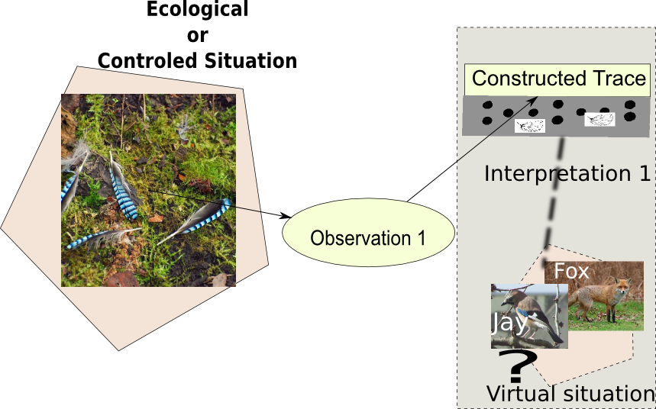
Introduction (1)

Slide 4
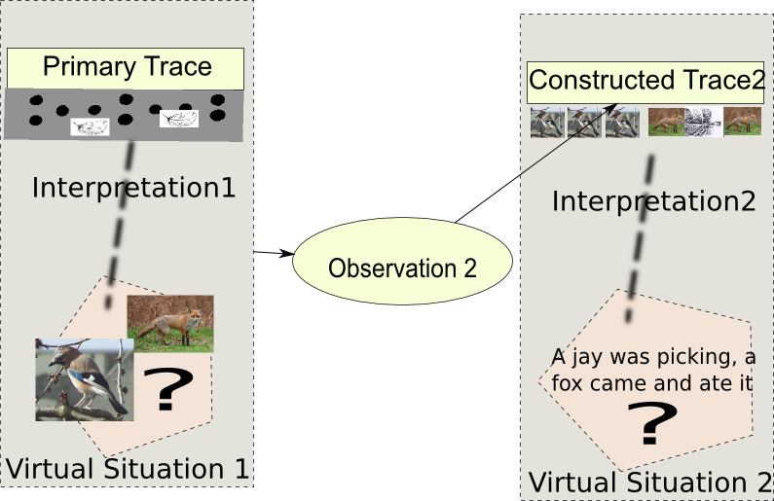
Introduction (2)

Slide 5
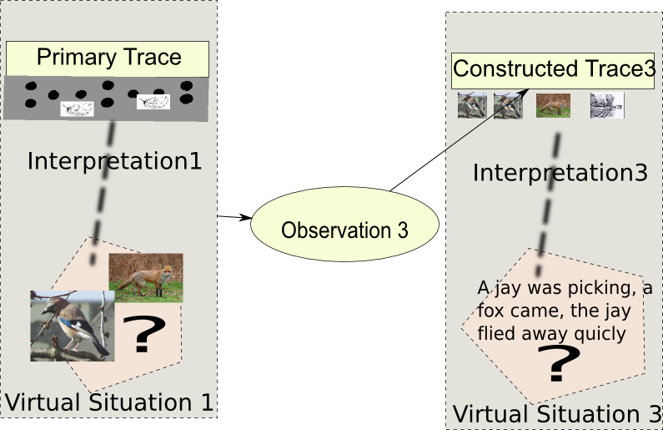
Introduction (3)

Slide 6
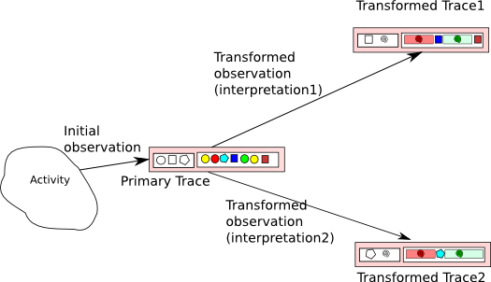
Knowledge Construction

Slide 7
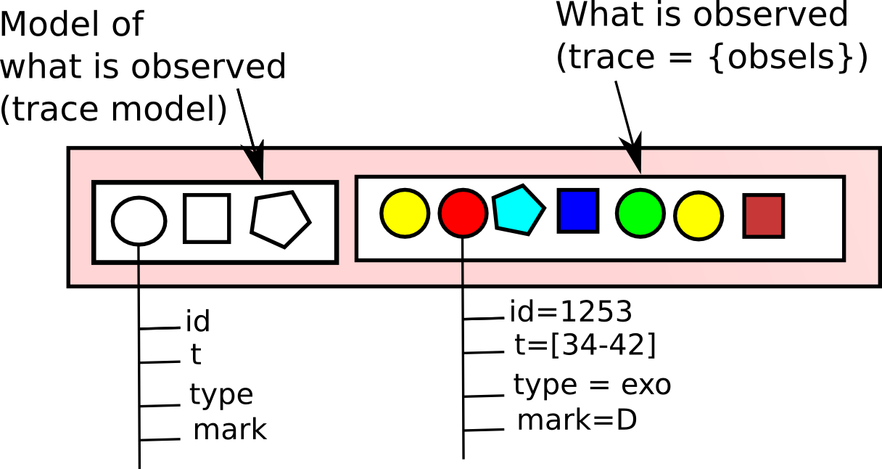
Modeled Trace

Slide 8
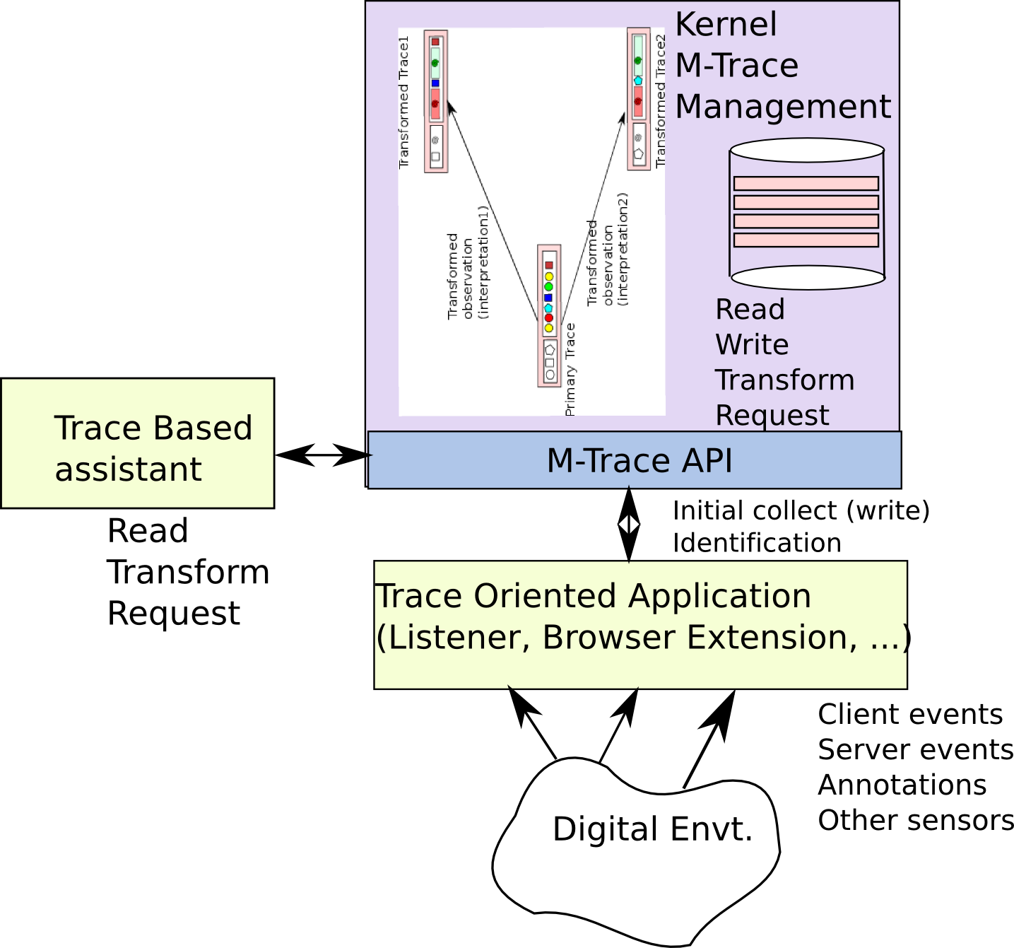
Managing M-Traces
Kernel Trace Based Management
System (RDF lib)
http://liris.cnrs.fr/sbt-dev/tbs/doku.php?id=public:ktbs

Slide 9
OBSERVING A MOOC
The learner logs in and get an ID (U-ID)
On the platform, or
With an Open ID
The learner selects a learning activity (A-ID)
On the platform (choosing a course)
(by defining its proper activity)
The learner asks to be traced
His trace is identified by [U-ID]+[A-ID]
His trace is stored in an independent repository, gathering server information and client information
The user can see and manage his M-Trace

Slide 10
Illustration (usual situation)
Browser
(client)
Platform
Server
Platform DB
Platform page
Platform
Listener
Logs
U_1

Slide 11
Illustration (platform events as obsels)
Browser
(client)
Platform
Server
Platform DB
Platform
Listener
Platform page
+ trace listener
Logs
kTBS– users
/ platform
U_1

Slide 12
Illustration (platform events as obsels)
Browser
(client)
Platform
Server
Platform DB
Browser
Extension
M-trace
Assistant
Platform
Listener
Platform page
+ trace listener
Logs
Browser (client) parameterized
Obsels collection
kTBS
Requests
kTBS– users
/ platform
U_1

Slide 13
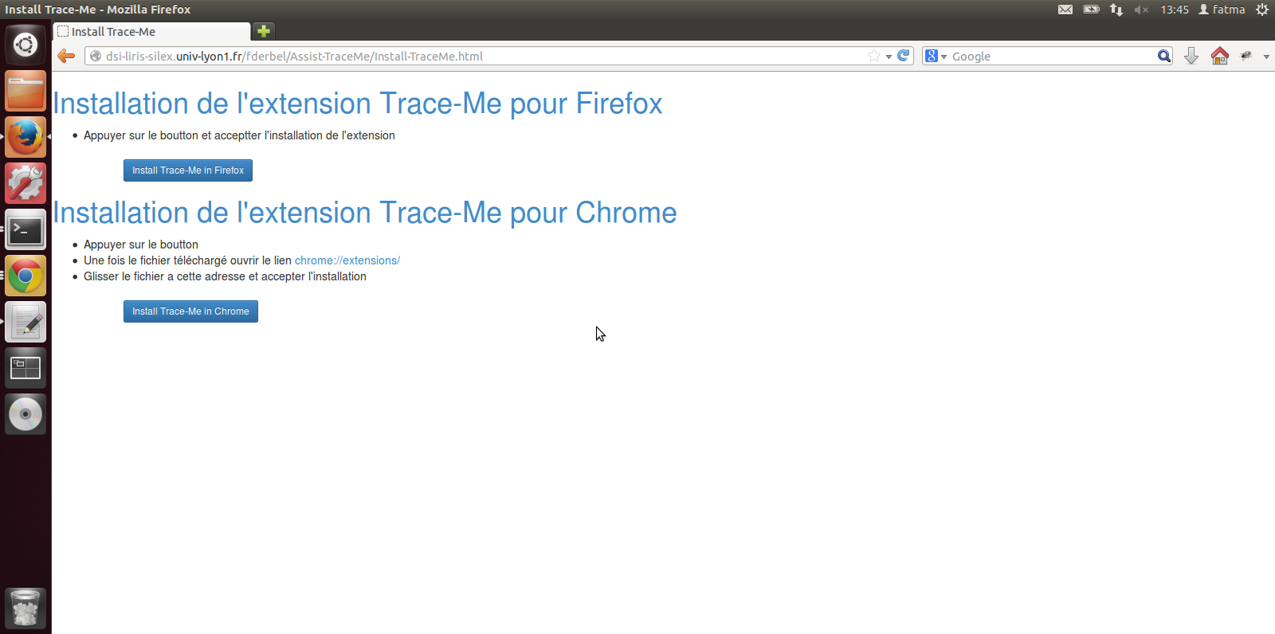
Example on Claroline Connect
Installing the extension

Slide 14
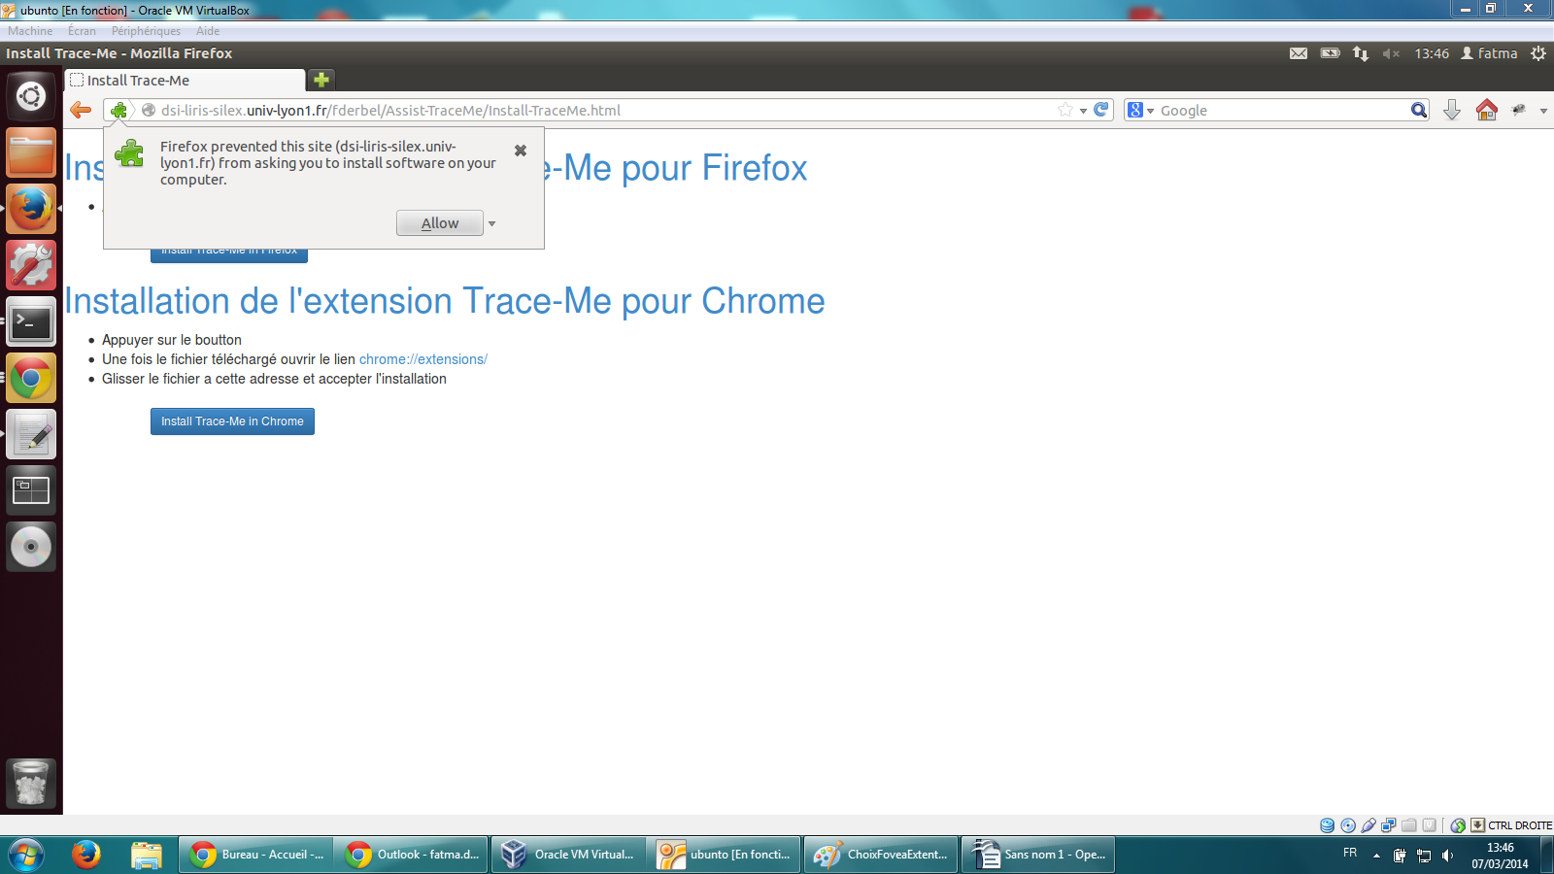
Example on Claroline Connect
Installing the extension

Slide 15
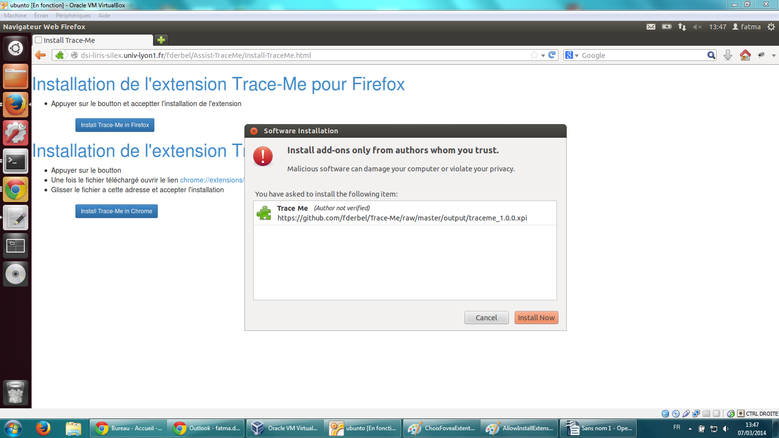
Example on Claroline Connect
Installing the extension

Slide 16
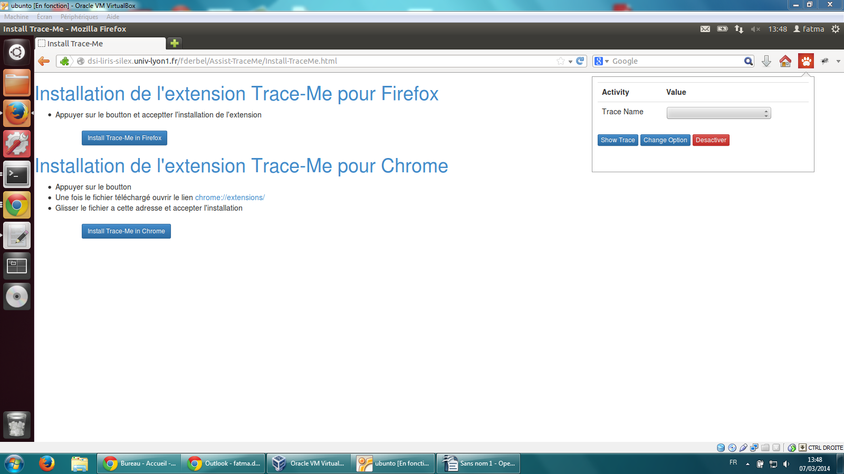
Example on Claroline Connect
Installing the extension

Slide 17
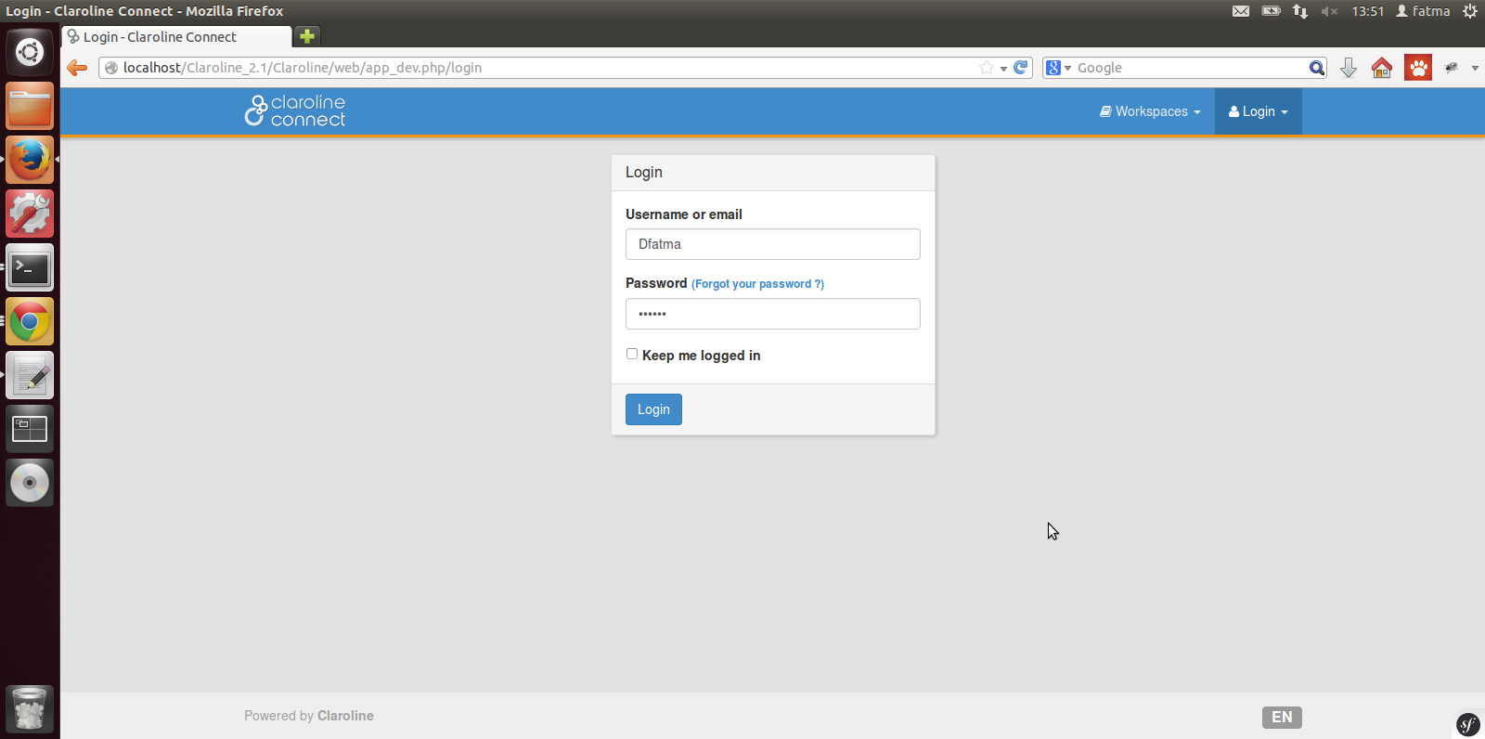
Example on Claroline Connect
Logging on the platform -> Getting the U-ID

Slide 18
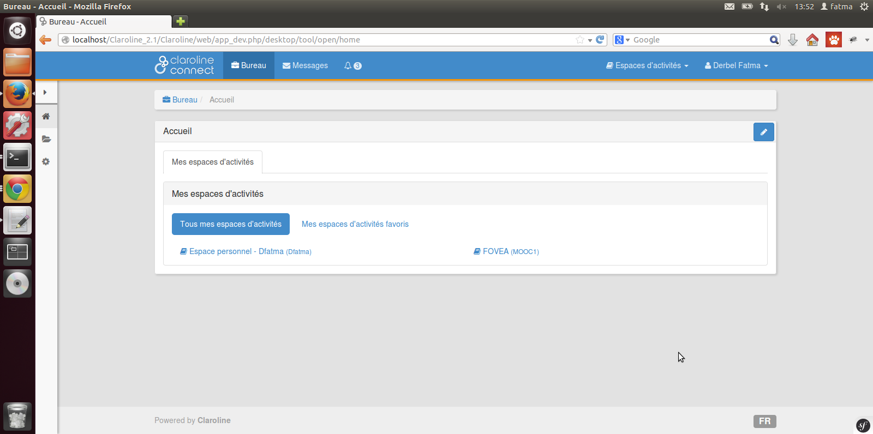
Example on Claroline Connect
Logging on the platform -> Getting the U-ID

Slide 19
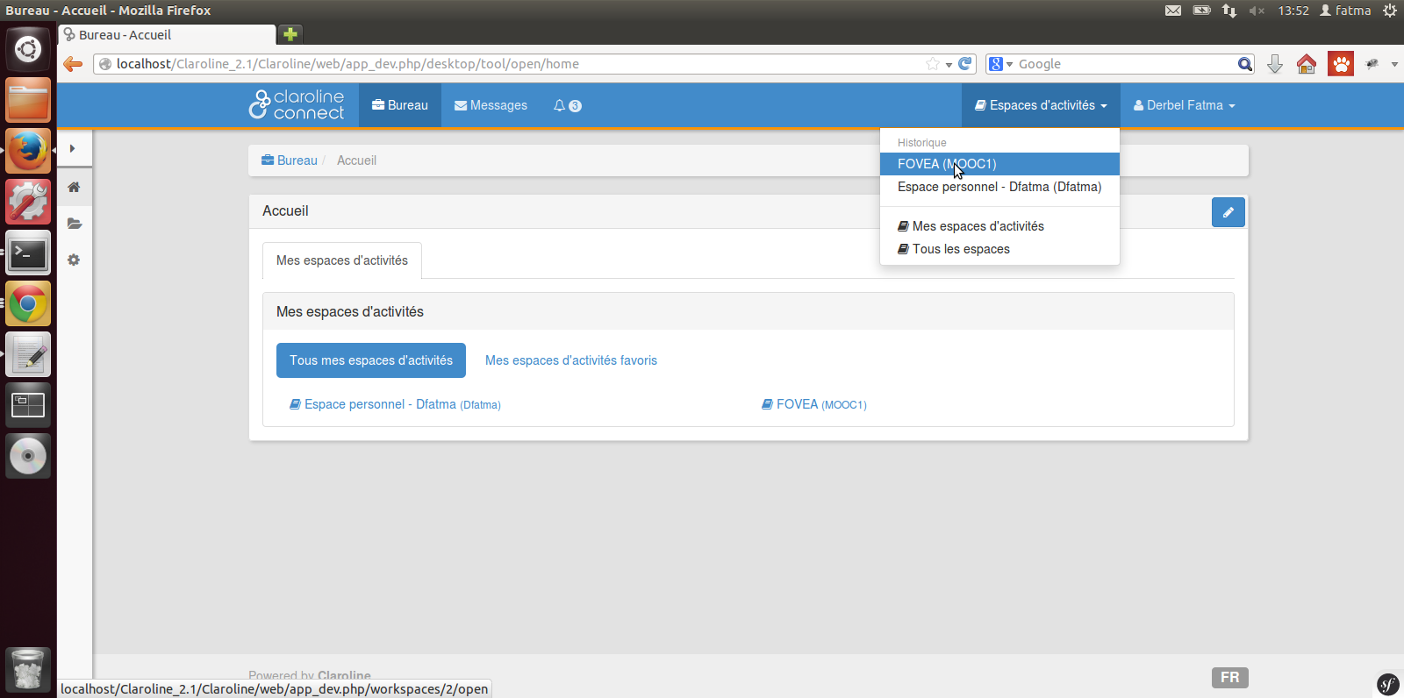
Example on Claroline Connect
Choosing a course -> getting the A-ID

Slide 20
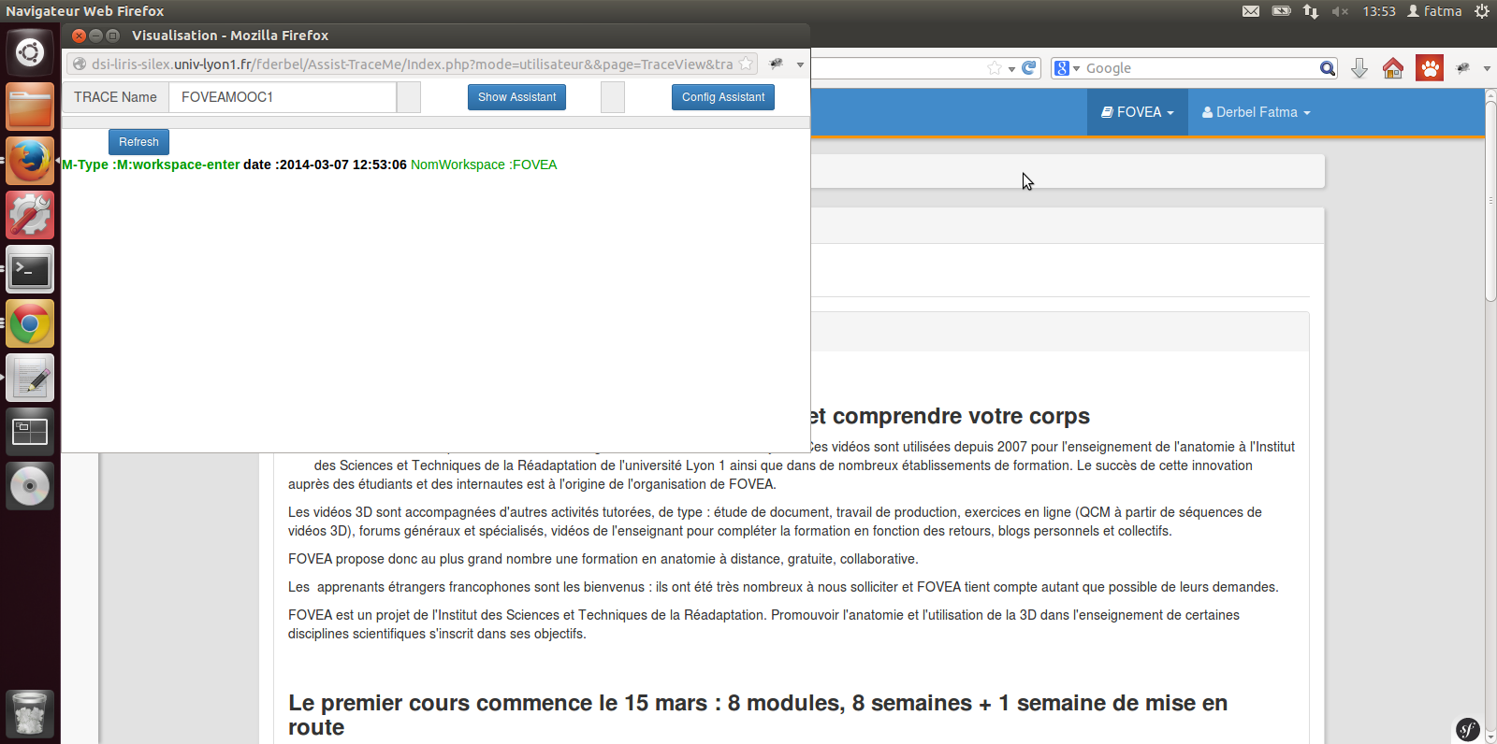
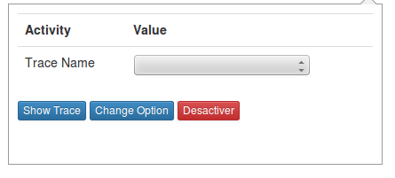
Example on Claroline Connect
Launching the M-Trace Assistant

Slide 21
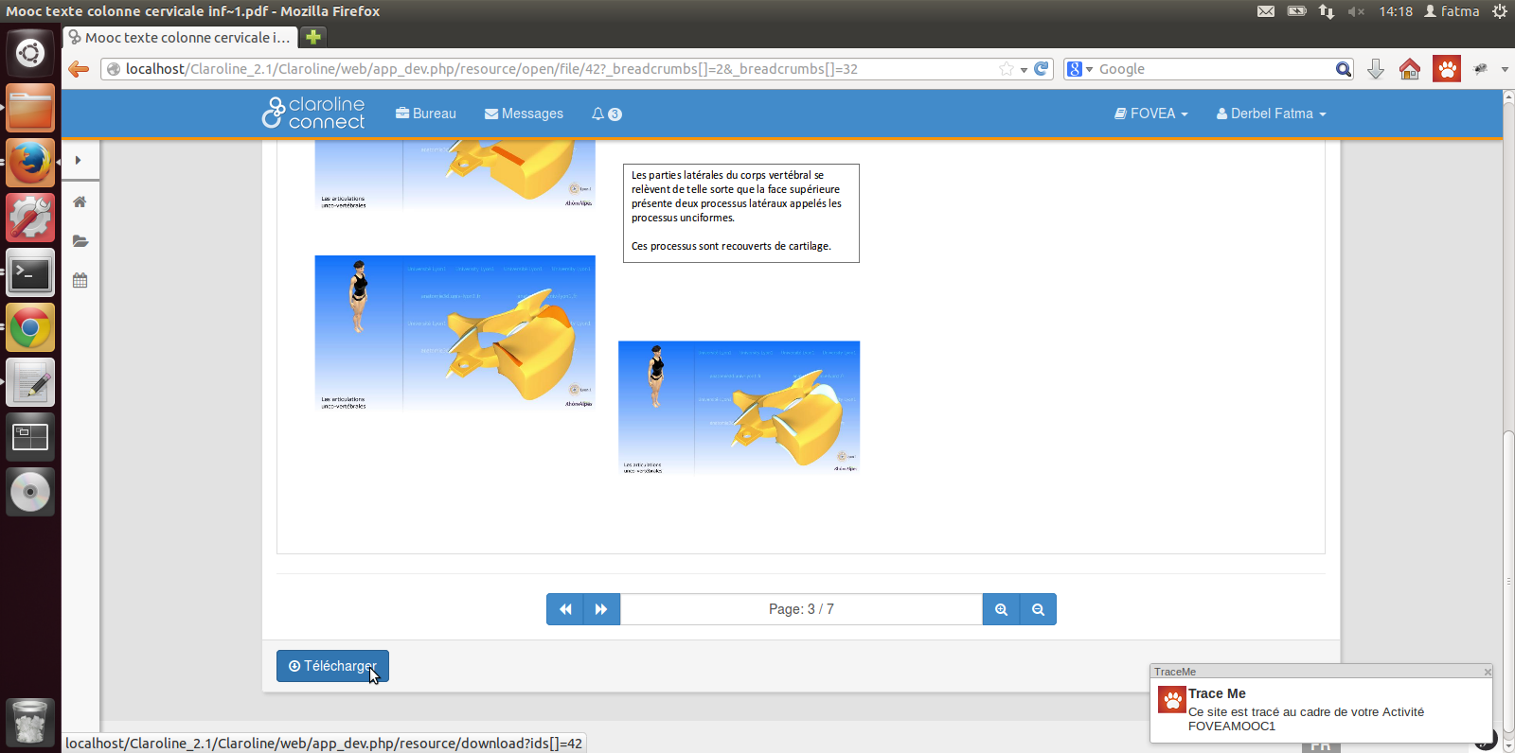
Example on Claroline Connect
The Open Learning Process : within the platform
Awareness

Slide 22
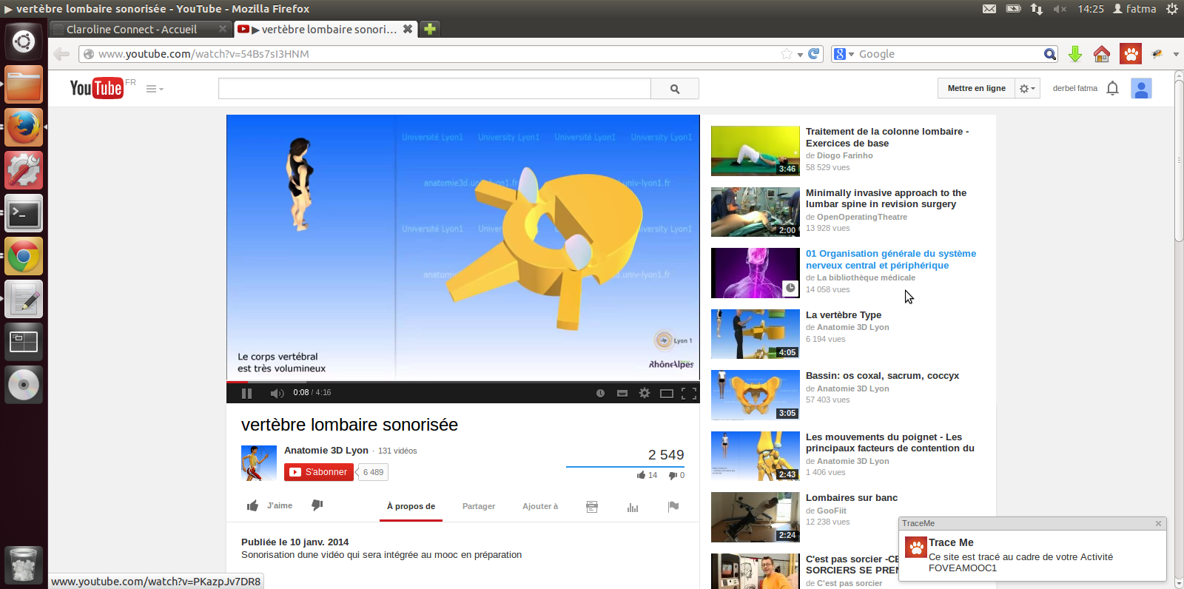
Example on Claroline Connect
The Open Learning Process : somewhere on the web
Awareness

Slide 23
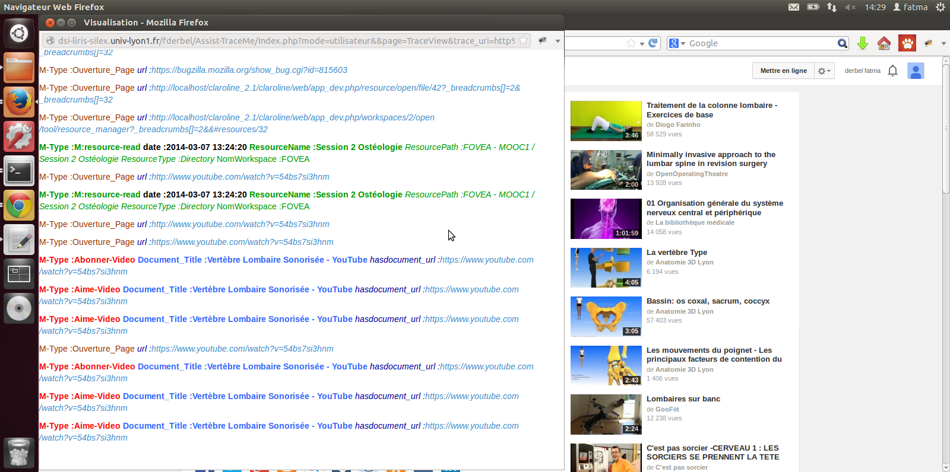
Example on Claroline Connect
Reflexivity on the learning trace : assistance

Slide 24
Further work…
« Universal » trace converter for MoocDB (Kalyan Veeramachaneni kalyan@csail.mit.edu + Quentin Agren) April-September 2014
Listener for Edx FUN : application in Lyon (Mooc on European Economy), ENS-Lyon
Experiment with the Mooc FOVEA (April-May 2014)
Development of a security service for a full user control of his M-Traces (PhD Thesis : Hoang Lé, Ozalid Project) (Defense in 2015)
Capitalizing various M-Traces repositories with explicit models for further research (Learners give their M-traces for scientific investigation) (FUN working group) (April-December 2014)
Enhancing performances of the kTBMS (a RDF lib) (February-December 2014)
Developing assistants with various visualization, indicators computations, API for platforms wishing to access the learner M-Traces (with a security token)

Slide 25
Other readings and biblio
Research questions and methods on the MOOCs What's new? (with surveys’ references)
Traced Experience Based Reasoning (other examples of using M-Traces for learning)
https://www.zotero.org/groups/coat_cnrs (a collaborative bibliography)
Publications (Alain Mille)
The GitHub of the kTB(M)S
The GitHub of TraceMe

Slide 26
DEMOS Needs a securized access…
During some break… ☺
The link to the kTBS http://clacodev.univ-lyon1.fr:8080/fderbel35/
The link to the trace http://clacodev.univ-lyon1.fr:8080/fderbel35/FOVEAMOOC1/@obsels
Creating a blog on his own learning space http://clacodev.univ-lyon1.fr:8080/fderbel35/Espacepersonnel-fderbelfderbel/@obsels
Visualizing the activity on his own learning space http://dsi-liris-silex.univ-lyon1.fr/fderbel/Assist-TraceMe/Index.php?mode=utilisateur&&page=TraceView&trace_uri=http%3A%2F%2Fclacodev.univ-lyon1.fr%3A8080%2Ffderbel35%2FEspacepersonnel-fderbelfderbel%2F
Visualizing the activity on the Mooc (client + server) http://dsi-liris-silex.univ-lyon1.fr/fderbel/Assist-TraceMe/Index.php?mode=utilisateur&&page=TraceView&trace_uri=http%3A%2F%2Fclacodev.univ-lyon1.fr%3A8080%2Ffderbel35%2FFOVEAMOOC1%2F
The assistant page : http://dsi-liris-silex.univ-lyon1.fr/fderbel/Assist-TraceMe/

